Slide 1
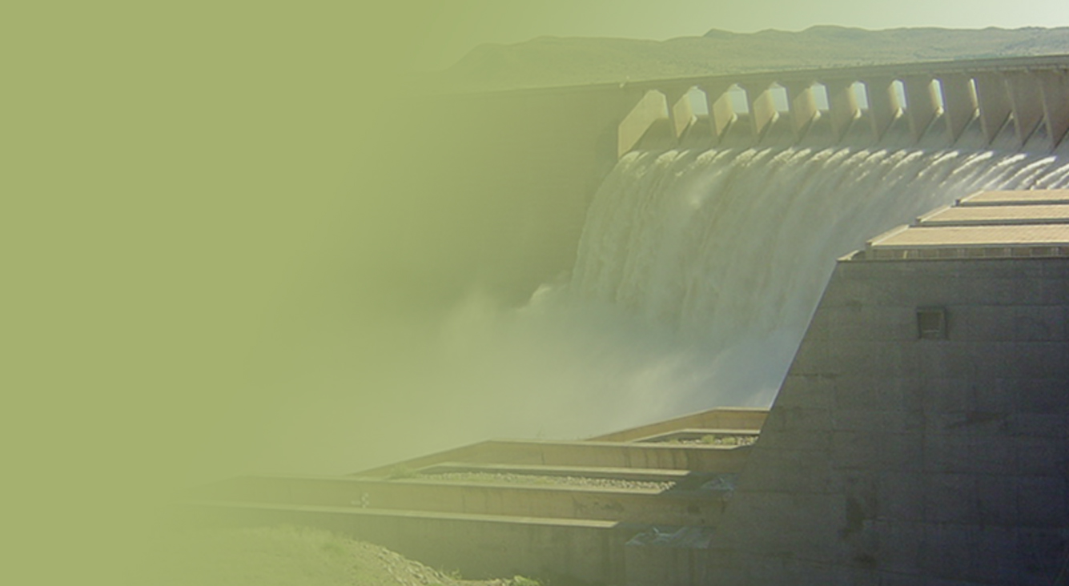
Status Report on the 2015/17 Drought
Portfolio Committee on Water and Sanitation
15 February 2017
Date: Tuesday 15 February 2017
PRESENTATION TITLE
Presented by:
Name Surname
Directorate
Date

Slide 2
Notes for Presentation
The ARC Umlindi report of 13 January 2017, based on the 12-month SPI: large parts of the country are still experiencing a mild drought, while small pockets of moderate, severe and extreme drought are still found. There is still a large area of severe to extreme drought in the southern part of the Eastern Cape and severe drought is also still found in the western part of Northern Cape, southern tip of Western Cape, eastern part of KZN, and eastern part of Mpumalanga.
While we are seeing some recovery in veld conditions we are not seeing the equivalent recovery in our dam levels. The recent mid-summer rains have still not really made a significant impact, we therefore need to continue to intensify the enforcement of restrictions to stretch our available water supplies. The drought is far from over and even with a normal season it will take a number of years for the system to stabilize to an acceptable level.
The Drought as far as water supplies are concerned is not over, current dam levels are lower than they were at the same time last year

Slide 3
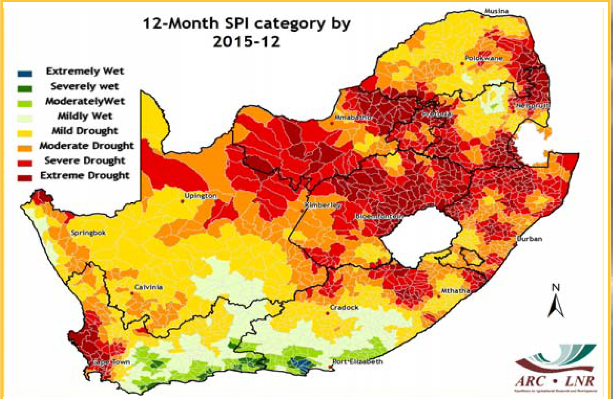
12-month SPI for Dec 2015 vs Dec 2016

Slide 4
SAWS Weekly Outlook

Slide 5
SAWS Weekly Outlook (Extract)
SAWS Weekly Outlook: the 6 February report reflects that: ENSO (El Nino / La Nina) is expected to remain in a neutral state for the remainder of the summer and autumn;
Forecasts for the remainder of the summer season is still likely to be above normal rainfall over most of the country, though with a much reduced likelihood; Good rain fell mostly over the central parts of the country;
More showers and thundershowers expected over central and eastern interior during the next weeks;
This could lead to more severe weather related hazards such as flooding, damaging winds; and The central-western and southern parts of the country still have a low likelihood of significant rain.
This forecast is not very optimistic with regard to the possible recovery of our dams.
While we have seen some slight improvements in dam levels with the national average increasing by 0.6%, there is still a very long road to recovery and we face the possibility of a difficult winter.

Slide 6
Drought and CURRENT Status of our dams

Slide 7
Summary of Water in Storage per Province on 6 February 2017
Province | FSC in 10⁶ m^3 | Number of Dams per Province |  |  |  | % of full capacity
 |  | Total | ≤10% | 10% to 40% | ≥100% | 08/02/16 Last Year | 30/01/17 Last Week | 06/02/17 This Week
Eastern Cape | 1 832 | 43 | 5 | 10 | 3 | 73,3 | 57,7 | 56,9
Free State | 15 971 | 19 | 4 | 7 | 3 | 54,4 | 56,7 | 57,2
Gauteng | 115 | 4 | 0 | 0 | 3 | 83,5 | 86,6 | 86,7
Kwazulu-Natal | 4 669 | 18 | 0 | 5 | 2 | 52,7 | 47,0 | 47,1
Lesotho* | 2 376 | 2 | 0 | 0 | 0 | 47,6 | 44,6 | 46,7
Limpopo | 1 508 | 26 | 0 | 4 | 10 | 61,1 | 63,7 | 66,1
Mpumalanga | 2 539 | 22 | 0 | 4 | 4 | 61,0 | 65,9 | 67,8
Northern Cape | 146 | 5 | 1 | 0 | 2 | 63,6 | 93,7 | 93,6
North West | 887 | 28 | 1 | 7 | 9 | 45,1 | 73,2 | 73,8
Swaziland* | 338 | 1 | 0 | 0 | 0 | 34,6 | 41,4 | 46,1
Western Cape O | 273 | 21 | 8 | 3 | 1 | 56,5 | 26,6 | 26,2
Western Cape W | 1 598 | 22 | 0 | 6 | 2 | 43,0 | 39,9 | 37,9
Western Cape | 1 870 | 43 | 8 | 9 | 3 | 45,0 | 37,9 | 36,2
Total | 32 247 | 211 | 19 | 46 | 39 | 54,9 | 55,0 | 55,6

Slide 8
Overview of National Status of Dams at 6 February 2017 (1)
Item | 10⁶ m³ | 30 Jan | 6 Feb | Comments
National Storage | 32 247 | 55,0% | 55,6% | Overall now up by 0,6% Last year: 54,9 %
Dams < 10% | 680 | 17 | 19 | 2 more: Corana (EC) and Kamanassie (WC)
10% < Dams < 40% | 7 431 | 44 | 46 | 2 more: Voëlvlei (WC) & Kouga (EC) now < 40%
Dams >100% | 1 238 | 35 | 39 | 4 more: Grootdraai (MP), Misverstand (WC), Setumo (NW) & Koppies (FS) now >100%
Eastern and Western Cape are decreasing, other provinces plus Lesotho & Swaziland are improving.
Vaal System: (see next +1 slide) | 10 565 | 64,7% | 65,5% | 14 dams serving, amongst others, Gauteng, Sasol, and ESKOM. System was 59,8% in 2016. 20% Irr achieved, U achieving overall 13,1%, 15% target
Orange River: Gariep Vanderkloof | 8 367 5 196 3 171 | 52,5% 52,4% 52,6% | 52,9% 53,6% 51,7% | System was 55,0% last year this time. 15% irrigation mostly achieved, OFS Tunnel not complying. Power generation still continues
Polokwane: | 254 | 50,1% | 52,2% | 2 dams, was 52,0%, non-compliance with restrictions.
Crocodile West: | 450 | 98,1% | 96,2% | 6 dams for Tshwane, Madibeng & Rustenburg. System was 74,1% last year this time
Klipplaat | 57 | 54,8% | 54,4% | 3 dams in the Beyers Naudé LM, Jansenville, Klipplaat & Waterford, was 83,1% last year.
Luvuvhu | 225 | 77,5% | 81,5% | 3 dams: Thohoyandou area, was 69,7% last year.

Slide 9
Overview of National Status of Dams at 06 February 2017 (2)
Item | Cap in 10⁶m³ | 30 Jan | 6 Feb | Comments (dams and systems below 40% in red)
Western Cape: Voëlvlei Berg River Theewaterskloof | 889 159 127 479 | 38,5% 42,0% 47,8% 33,6% | 36,9% 39,8% 45,8% 31,8% | 6 dams for the City of Cape Town, 45,0% last year. 20% Urban not achieved 30% for irrigation now being considered. Cape Town preparing for tighter restrictions to achieve 20% restriction on Urban use
Brandvlei Clanwilliam Kwaggaskloof | 286 122 169 | 31,1% 50,4% 32,5% | 28,9% 46,9% 32,5% | Compliance with Ir:40% restrictions.
Algoa System: | 282 | 53,4% | 52,2% | 5 dams for Nelson Mandela Bay, (90,1%) restrictions on urban not achieved - overabstraction
Amatole System: | 241 | 72,4% | 72,4% | 6 dams for Buffalo City (92,9%)
Umgeni System: Inanda Midmar Albert Falls | 923 237 235 288 | 48,7% 60,8% 58,9% 25,2% | 48,7% 60,3% 59,2% 24,7% | 5 dams serving Ethekwini & Msunduzi System was 58,4% last year this time D:15%, I:15%, Ir:50%. Achieving 67% of the 15% restriction target on urban.
Hazelmere Pongolapoort | 18 2 267 | 65,6% 38,0% | 64,2% 38,0% | Restrictions temporary relaxed at Hazelmere Dam, level kept below 67% due to construction.
Goedertrouw Hluhluwe Klipfontein | 301 26 18 | 26,8% 22,2% 33,5% | 27,5% 21,8% 35,0% | D:40%, Ir:80%, In:15% restrictions achieved D:20%, Ir:80%, In:20% restrictions achieved, rationing Restrictions not achieved, rationing imposed
Bloemfontein: | 223 | 37,9% | 37,9% | 4 dams serving Mangaung, was 30,3% last year 67% compliance to the D:30% restriction.

Slide 10
Intervention by restrictions

Slide 11
Intervention by restrictions
Restrictions are used on systems facing deficits to prolong the water supply during periods of water shortage.
Restrictions are applied to stop supplying less critical uses in order to avoid emptying the water resource completely.
For urban use, critical use include water for the house, unlike gardening, swimming etc.
Restrictions are gazetted by the Minister (or as delegated) and if implemented, lasts until the drought is broken.

Slide 12
Intervention by restrictions (Operating Rules)
Equitable supply of water to ensure optimal distribution to meet user requirement schedules
Restriction during drought conditions to mitigate against risk of failure to supply water, starting with users with lower assurance of supply so that critical supplies may be sustained for as long as possible
Pre-releasing during flooding conditions to mitigate against risk of flood damage by discharging excess water safely while minimizing losses through spillage .
Minimize operational costs by, for example, prioritizing systems supplying water by gravity or minimum head resistance
Reducing water loss by supplying through and/or storing in as many as possible systems with minimal leaks, evaporation, etc.

Slide 13
Intervention by restrictions (Operating Rules)
Water quality management by releasing more water into systems with pollution problems in order to dilute the polluted water and maintain water resource quality objectives
Facilitating infrastructure maintenance by taking into account times when parts of the infrastructure configuration will have to be out of commission to do required maintenance so that water supplies are not disrupted
Maximize system yield by optimizing integrated operation or conjunctive water use of local resources including surface water, ground water, rainwater harvesting, return flows, water re-use etc,
Communication, public participation and capacity building by ensuring that implementation of operating rules is transparent and inclusive, showing the volume of water to be shared or restricted for the given storage level and/or period.

Slide 14
Intervention by Restrictions: (9)
Restriction Notices:
C = Compliance or restricted, P/C = partial compliance, U = Unknown at this stage.
Province | Notices Published | Notices in Draft | Notices by CMAs | C | P/C | U | Comments
Western Cape | 2 Systems | 1 system |  | 1 | 1
Mpumalanga | 7 Dams | - | 4 | 1 | 1 | 6
Northern Cape | 1 System | - | - | 1 |  |  | Ground Water use restricted
KwaZulu-Natal | 9 (incl 5 systems) | - | - | 6 | 1
Freestate | 6 (incl 1 System) |  | - | 3 | 2 | 1
Limpopo | 13 (1 System) |  | - | 5 | 5 | 2
North West | 9 | 1 | - | 1 |  | 7
Eastern Cape | 10 (incl1 system) | - | - | 1 | 1 | 6
Gauteng | 1 System | - | - |  | 1 |  | Integrated Vaal System
TOTAL | 58 Schemes (incl 12 systems) | 1 dams (incl 1 system) | 4 | 19 | 12 | 22

Slide 15
Emergency interventions

Slide 16
5. DROUGHT INTERVENTION BOREHOLES
Province | Number of boreholes (emergency programmes)
DWS, DAFF & CoGTA & NGO Reports | Refurbished or equipped | Newly Drilled | Total Working
Kwa-Zulu Natal | 277 | 350 | 568
Free State | 48 | 103 | 308
Limpopo | 5 | 192 | 1 750
Mpumalanga | 168 | 115 | 1 094
North West | 147 | 152 | 3 112
Eastern Cape | 30 | 58 | 232
Northern Cape | 29 | 18 | 344
Western Cape | * | * | 50
Gauteng | * | 38 | 29
TOTAL | 704 | 1026 | 7 487
Note that reports on boreholes still require much verification.
Although it is estimated that there may be about 30 000 production boreholes countrywide, many are not operational.
The situation is also very dynamic, it changes daily as boreholes are drilled and or equipped every day while others are vandalised, equipment stolen or groundwater levels drop too low to be utilised.
* No information available.
Notes:
Reports in general are incremental appears to be inconsistent. Difficult to determine which are needed, planned, in progress or completed in a numbe rof cases.
Will develop a sound zero based database and then rebuild the statistics with the aid of the regions.

Slide 17
6. DROUGHT INTERVENTION THROUGH TANKERS
Province | Number of Tankers (Trucks) |  |  |  |  | Mobile Tanks
 | DWS in Dec 2016 | DWS in Jan 2017 | Municipalities | Others | Total
Kwa-Zulu Natal | (0+44)=44 ! | 44 ! | 10 | 96 hired | 150 | 7
Free State | 14 | 31 | 65 | 1 GotGs | 80 | 3
Limpopo | 0 | 0 | 78 | * | 78
Mpumalanga | 0 | 0 | 68 | * | 68 | 4
North West | (22+3)=25 ! | 15 +3 ! | 108 | * | 133 | 2
Eastern Cape | 9 | 4 | 44 | * | 53 | 1
Northern Cape | 0 | 0 | 2 | * | 2
Western Cape | 0 | 0 | 10 | * | 10
Gauteng | 0 | 0 | * | * | 0
TOTAL | 92 | 66 | 385 | 97 | 574 | 17
! Including a number of DWS construction tankers each day
All non-construction DWS tankers have been withdrawn since
1 Feb 2017
GotGs: Gift of the Givers
* No information available.

Slide 18
FUNDING EXPENDED: DWS
Treasury allocated R 341,3 million to DWS as an appropriation of expenditure for 2016/7 Financial Year, specifically for drought alleviation.
R 290,7 million has been earmarked for a desalination plant at Richards Bay.
Of these, R 213,7 million (73%) was used by December 2016.
Progress made:
Four modules on site and tested: capacity 3,5 ML/day
3 More modules, capacity 3ML/day procured
Plant is producing 1ML/day already
All pipes connected
Project on track, target for completion February 2017.
The remainder R 50,6 million was used for tankering of water as well as small, semi mobile reservoirs to areas in the Eastern Cape, Free State, North West and KZN.

Slide 19
Eastern Cape

Slide 20
Eastern Cape
Algoa System: 5 dams serving Nelson Mandela Bay: this week an decrease of 1.2% to 52.2%. Last year at the same time were at 90.1%.
Amathole System: 6 dams serving Buffalo City: this week steady at 72.4%. No restrictions in place. Last year at the same time were at 92.9%.
Mnquma LM (Butterworth):
Xilinxa Dam currently at 2% last release has been made to the Gcuwa Dam which is at 30.5%, under current conditions supply will run out towards end February 2017;
A total population of 130000 will be affected;
A contractor has been appointed to equip the Butterworth and Toleni boreholes this week:
Water rationing has been implemented to reduce consumption from 14 Ml/day to 3 Ml/day (water available 05:00 to 09:00 and 17:00 t0 20:00 daily):
10 Municipal water tankers are in operation.
Kareedouw: requires emergency intervention, Eerstebos and Derdebos streams dry and Driekrone Dam almost empty, emergency borehole will be equipped.

Slide 21
Free State

Slide 22
Free State
Bloemfontein System: 4 dams serving mainly Mangaung. This week steady at 37.9% compared with 30.3% the same time last year. There is still flow in the Caledon River and we continue to pump from the Tienfontein Pump station on the Caledon. Restrictions of 30% for urban and 75% for irrigation in place. Only 67% compliance with restrictions for domestic use.
Orange River: The Gariep dam is at 53.6% an increase of 1.2% and Van Der Kloof Dam 51.7% a decrease 0.9%.
Dams Operated by Municipalities:
Capacity is estimated but does not take into account siltation over the years;
Water demand is mostly higher than expected yield;
In winter most dams run dry impacting negatively on water supply;
Desiltation systems to be installed in future e.g assessment of various sand traps options available for raw water;
To improve operations and monitoring of water resources, dam surveys will be conducted & gauge plates will be installed at municipal dams better manage future operations

Slide 23
Free State
Despite the slight improvement of levels of the Meulespriut, Marquad, Cyferfontein, De Put and Sandspriut Dams as well as the work done by the DWS in providing tankers and refurbishment of boreholes the Province have raised concerns re the lack of support to the Setsoto Municipality with regard to the re- imbursement of costs incurred by the Municipalities.
Mitigation Measures: the following mitigation measures have been implemented to improve water security:
Water conservation and water demand management (War on Leaks)
Surface water resource management (Optimised the operation of the Caledon and Orange River System)
Managing and use of groundwater resources (drilling and equipping additional boreholes)
Re-use of water (Mangaung Metropolitan Municipality)
Eradication of invading alien plants/catchment care (WfW)
Eradication of illegal water use (Enforcement in the Caledon and Orange River System)
Development of surface water resources, investigation of raising dam walls
Transfer of water (LHWP Ph2, investigation of the emergency transfer Sterkfontein to Fika Patso)
Rainwater harvesting (provision of tanks in selected areas)
Early warning monitoring of water services (Monday/Wednesday and Friday)

Slide 24
Gauteng

Slide 25
Gauteng
The Vaal River System: 14 dams. Serving mainly Gauteng Sasol and Eskom has increased by 0.8% to 65.56% compared with 59.8% the same time last year. The system has gained 89 million M3 week on week. Katse dam is at 45.8% increased by 0.2%. Vaal Dam decreased by 0.3% to 63.1%. The Sterkfontein Dam increased by 0.3% to 87.6%. The Grootdraai Dam is at 105% a increase of 5.8%. Restrictions of 15% for urban use and 20% for irrigation use in place.
Pumping continues from the Upper Tugela Transfer Scheme into Sterkfontein- and from Heyshope Dam into Grootdraai Dam (Usutu Scheme).
The update on the application of restrictions by Municipalities will be available after the meeting of the Technical Committee scheduled for 18 January.

Slide 26
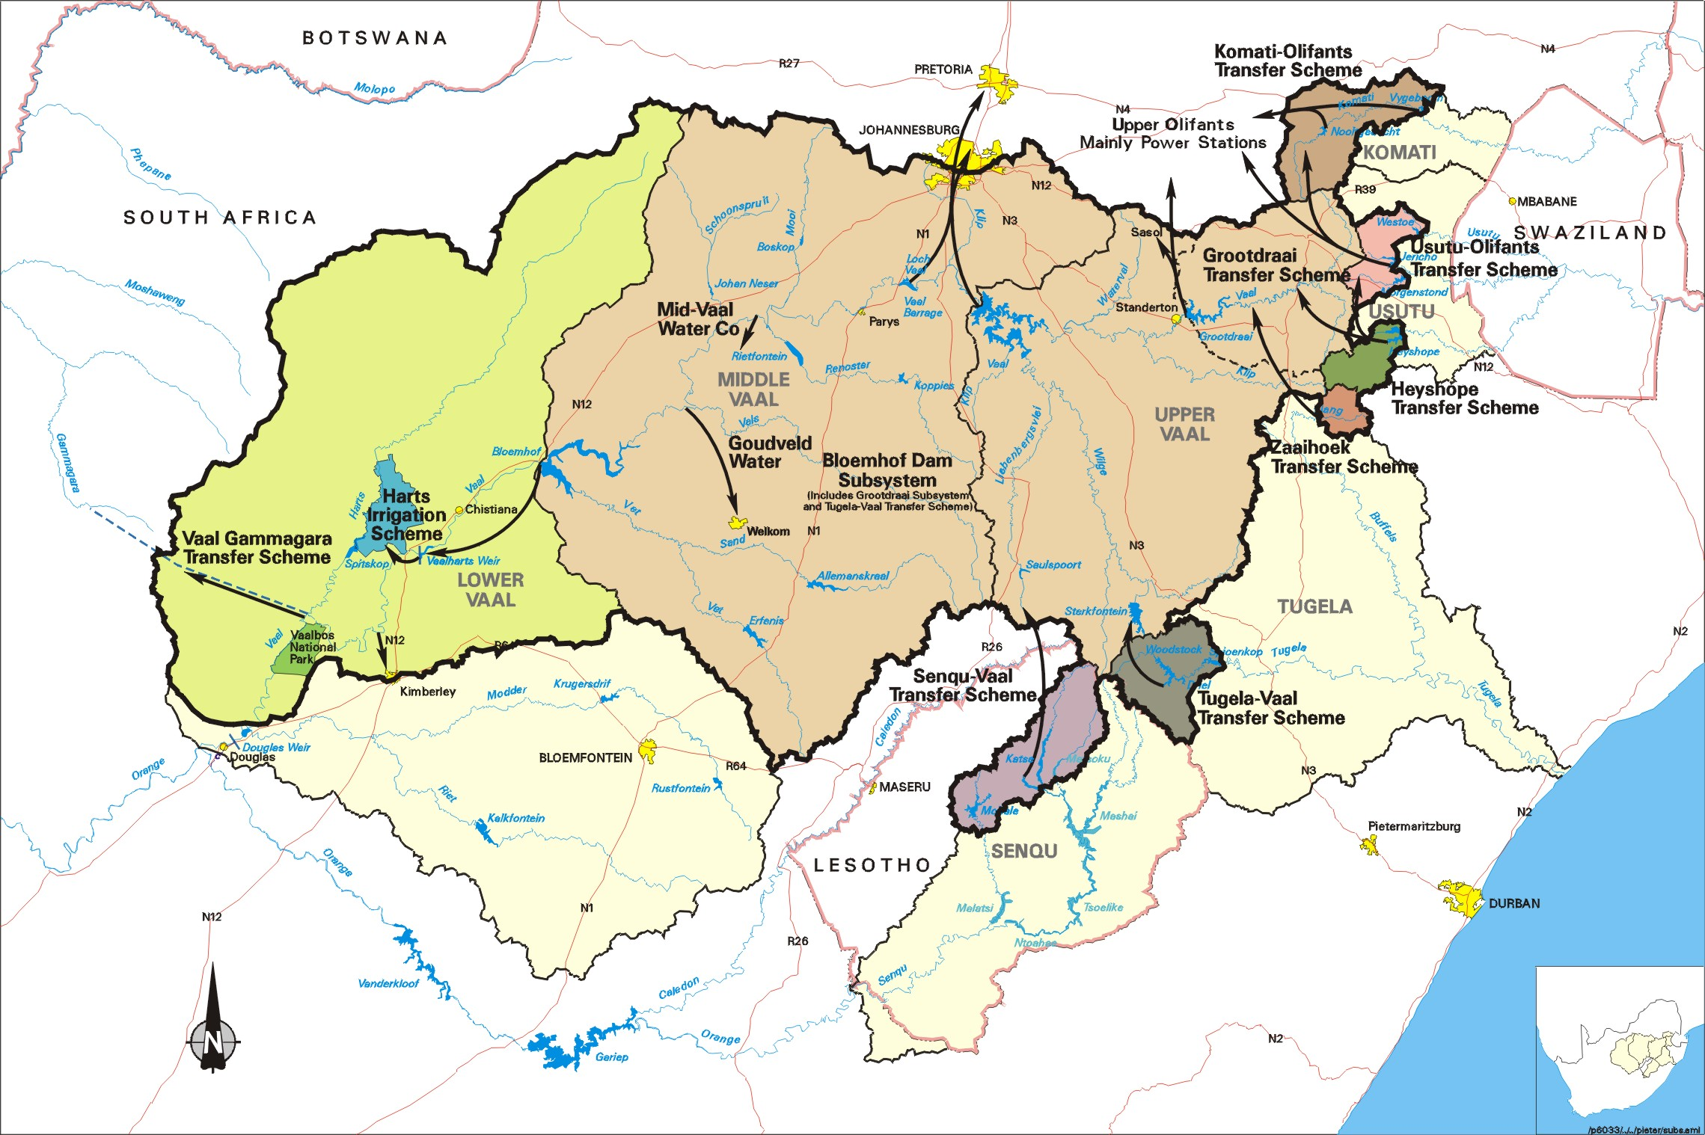
RUSTENBURG
Vaal
Bloemhof Dam
Katse
Mohale

Slide 27
Overview of Dams in the Integrated Vaal System 06 Feb 2017
DAMS | FSC in 10⁶ m³ | 08/02/16 Last year |  | 30/01/17 Change over 1 week. |  |  | 06/02/2017 Change over 1 week.
 |  | % | CAP | % | CAP | Δ | % | CAP | Δ
Vaal System | 10 565 | 59,8 | 6 318 | 64,7 | 6 835 | +52 | 65,5 | 6 924 | +89
Vaal | 2 603 | 51,8 | 1 348 | 63,4 | 1 651 | +5 | 63,1 | 1 643 | -8
Sterkfontein | 2 617 | 87,5 | 2 290 | 87,3 | 2 285 | +9 | 87,6 | 2 292 | +7
Grootdraai | 350 | 65,4 | 229 | 99,2 | 347 | -3 | 105 | 366 | +19
Katse | 1 519 | 59,8 | 908 | 45,6 | 692 | +11 | 45,8 | 695 | +3
Mohale | 857 | 25,9 | 222 | 42,8 | 367 | +1 | 48,3 | 414 | +47
Woodstock | 373 | 87,3 | 326 | 84,8 | 317 | +15 | 85,5 | 319 | +2
Nooitgedacht | 78 | 65,1 | 51 | 72,7 | 57 | 0 | 72,0 | 56 | -1
Vygeboom | 78 | 70,8 | 55 | 101 | 79 | +1 | 101 | 79 | 0
Morgenstond | 100 | 54,0 | 54 | 58,0 | 58 | 0 | 57,8 | 58 | 0
Westoe | 60 | 46,3 | 28 | 75,4 | 45 | 0 | 75,3 | 45 | 0
Jericho | 59 | 75,8 | 45 | 76,5 | 45 | -1 | 75,0 | 44 | -1
Heyshope | 445 | 87,6 | 390 | 81,3 | 362 | +1 | 81,0 | 360 | -2
Zaaihoek | 185 | 58,8 | 109 | 52,3 | 97 | +15 | 52,2 | 96 | -1
Bloemhof | 1 240 | 21,3 | 477 | 35,0 | 434 | 0 | 36,7 | 455 | +21

Slide 28
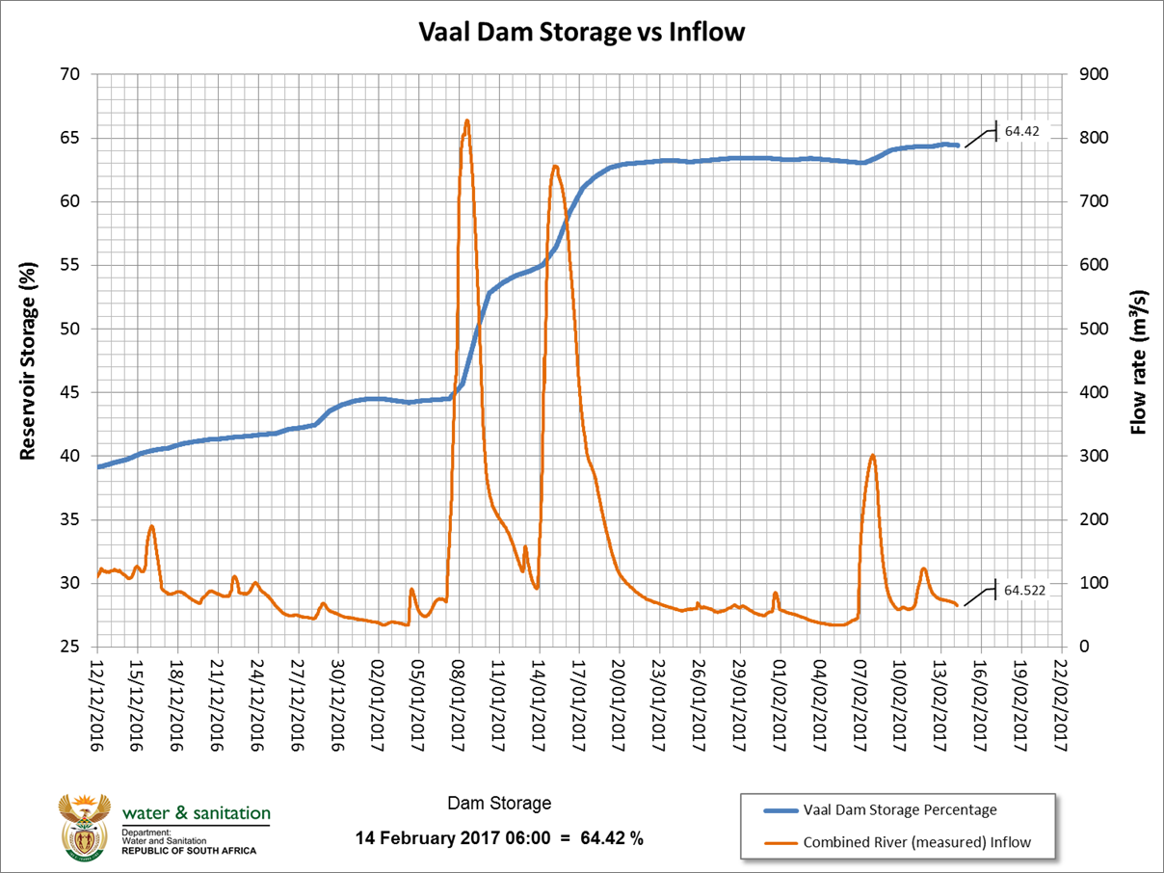
Vaal Dam
64.42%
Peak inflow
8/01/2017
640 m³/s
Inflow
64.52 m³/s

Slide 29
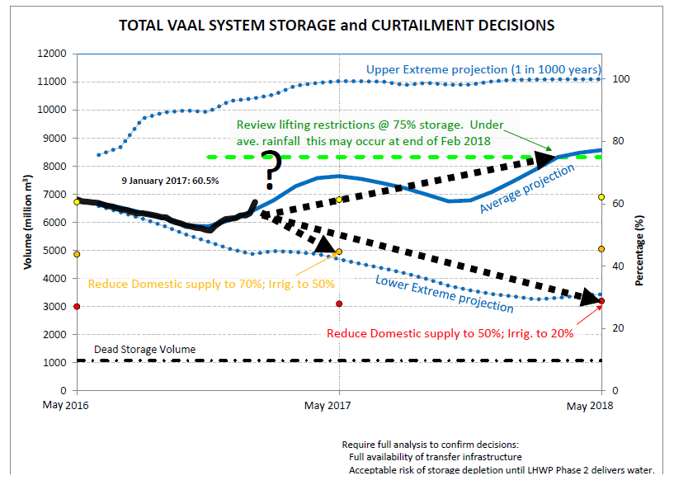

Slide 30
15% Restrictions
Both the Technical Committee and the Gauteng JOC on restrictions have commenced meetings on a weekly basis.
The Technical Committee met on 8 February. There has been a deterioration since last week and we are not meeting the target of 15%, this week achieved 13.1%.(down 0.7%)
The winners this week are:, Mogale City (down 27.8%), Merafong LM (down 27.9%), Rand West LM (down 20.4%), Rustenberg LM ( down 24.2%), Mestimaholo LM (down 15.8%), Ngwathe LM (up 17%)and Royal Bafokeng LM (down 17.1%).
The losers this week are: City of Johannesburg (up to 12.5%), Tshwane (down 14.2%), Emfuleni (down 12%) Govan Mbeki LM (14.3%), Victor Khanye LM (11.8%),
The Hospital cases this week are: Ekurhuleni (down 9.1%), Thembisile LM (up 7.9%), Midvaal LM (down 6.7%), Madibeng (down 7.6%) and Lesedi LM (up 7.7%).
With regard to Midvaal they have experienced difficulties in getting their largest consumer (a Brewery) to reduce consumption, we will be given them assistance in evaluating the extent of savings and benchmark against other breweries.

Slide 31
Kwazulu-Natal

Slide 32
Kwazulu-Natal
Most parts of KZN have received fairly normal rainfall this summer season so far, and the smaller water supply systems and systems abstracting directly from rivers have recovered. However, the large supply systems with large storage capacity including the two largest in KZN, the Mgeni and Mhlathuze systems have not recovered.
Umgeni Dam system. 5 dams serving mainly eThekwini and Msinduze. This week steady 47.3%. System was at 58.4% last year. Hazelmere is at 64.2% an decrease of 1.4%. Albert Falls decreased by 0.5% to 24.7%. Midmar dam an increase of 0.3% to 59.2%. Restrictions of 15% for domestic, 50% for irrigation and 15% for industry in place.
Other KZN dams which remain dangerously low: Klipfontein at 35 increase 1.5%; Hluhluwe at 21.8% decrease of 0.4%; and Goedertrouw 27.5% an increase of 0.8%, Pongolapoort steady at 38%..

Slide 33
Kwazulu-Natal
The average rainfall that has been received is making the public appreciation of the need for on-going restrictions in these systems a challenge.
KZN JoC’s still remain active.
Municipalities have been advised to reprioritise WSIG for any drought interventions excluding water carting.
KZN disaster management has received R150 million to assist with drought.
The desalination plant in Richards bay which will be commissioned in February 2017 (7 months).
The Tugela Emergency transfer scheme is quite advanced in the preparation for implementation and the Service Providers have been appointed.

Slide 34
Limpopo

Slide 35
Limpopo
Polokwane System: 2 dams. Increase of 2.1% to 52.2%. System was at 52% at the same time last year. Restrictions of 20% for all users are in place.
River Flows: There is an improvement in river flows following the rains over the last two weeks:
Limpopo River at Beit Bridge flowing at 97.6 m³/s
Limpopo River at Sterkloop flowing at approximately 16 m³/s
Great-Letaba River flowing at Engelhardt (KNP) flowing at 6.2 m³/s
Levuvhu River at Mhinga flowing at 5.7 m³/s.
Klein Letaba River at Tabaan flowing at 0.5 m³/s.
Palala River at Visgat flowing at 4 m³/s
Glen Alpine Dam in the Mogalakwena River spilling at 10.5 m³/s

Slide 36
Limpopo
Groundwater systems: There is a notable decline in groundwater levels at the majority of monitoring stations due to very limited recharge since 2014:
The effect of lack of recharge over past two seasons account for almost 91% of monitoring boreholes currently being lower than in September 2015.
Despite the current declining trend historical data indicate that levels are generally still much above the critical levels reached in earlier droughts such as the early nineties.
In most areas the groundwater resource can withstand another, or even two seasons, of poor recharge.
Exceptions exist, drastically declining groundwater levels and failing of production holes due to lack of resource management can be identified at a few localities but so far still limited to localised occurrences.
Areas requiring observation are: Tshakhuma, Mutale, Vondo RWS area, Nzhelele, Hout River Dam supply area and Albasini Dam supply area

Slide 37
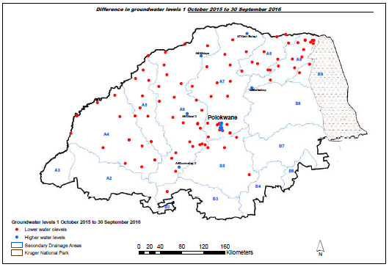

Slide 38
Mpumalanga

Slide 39
Mpumalanga
Mbombela LM (Barberton):
Suidkaap Water Plant: DWS funding (R34 million) this treatment plant has just undergone major refurbishment and completed in August 2015. Refurbishment work includes installation of mechanical, electrical components, 7.5km bulk pipeline, two new concrete reservoirs and sludge drying bed.
The Rimmers Creek Water Plant currently delivers about 0.5 ML/day against its design capacity of 16.6Ml/day. This reduction in delivery capacity is drought related due to the drying up of the Lomati dam which is the major source of water for Barberton.
Severn newly drilled boreholes has been brought to services since September 2016.
Combined delivery capacity amounts to 1.05 ML/day: The total amount of 6.55 ML/day is served to the residents of Umjindi. Water rationing and pressure reduction has been introduced to lessen the demand and supply.
An additional 80 000 litre storage tank has been installed at the township.

Slide 40
Mpumalanga
Mkhondo:
Serviced from three Water Treatment Plants i.e. Piet Retief Water Plant (old and new unit), Amsterdam Water Plant and Driefontein Water Plant. The combined water delivery capacity of the three water treatment plants is 22.8Ml/day.
The Mkondo Municipal supply is linked to the DWS operated Usuthu Bulk Water Transfer Scheme linked to the four major dams (Westoe Dam, Jericho Dam, Heynshoop Dam and Morgenstond Dam) in the Usuthu River Catchment.
Piet Retief receives a supply through a release of 7 m³/s from Heynshoop Dam.
DWS released water Municipal Gabosch Dam (Amsterdam) whenever the level drops to critical levels, through this intervention have managed to avert water shortages
The drought impacted on groundwater leading drying up 32 boreholes.
The Municipality deployed three water tankers to services affected 84 communities.
A total of 310 boreholes are in still in operation and mainly servicing the needs of rural communities.

Slide 41
Northern Cape

Slide 42
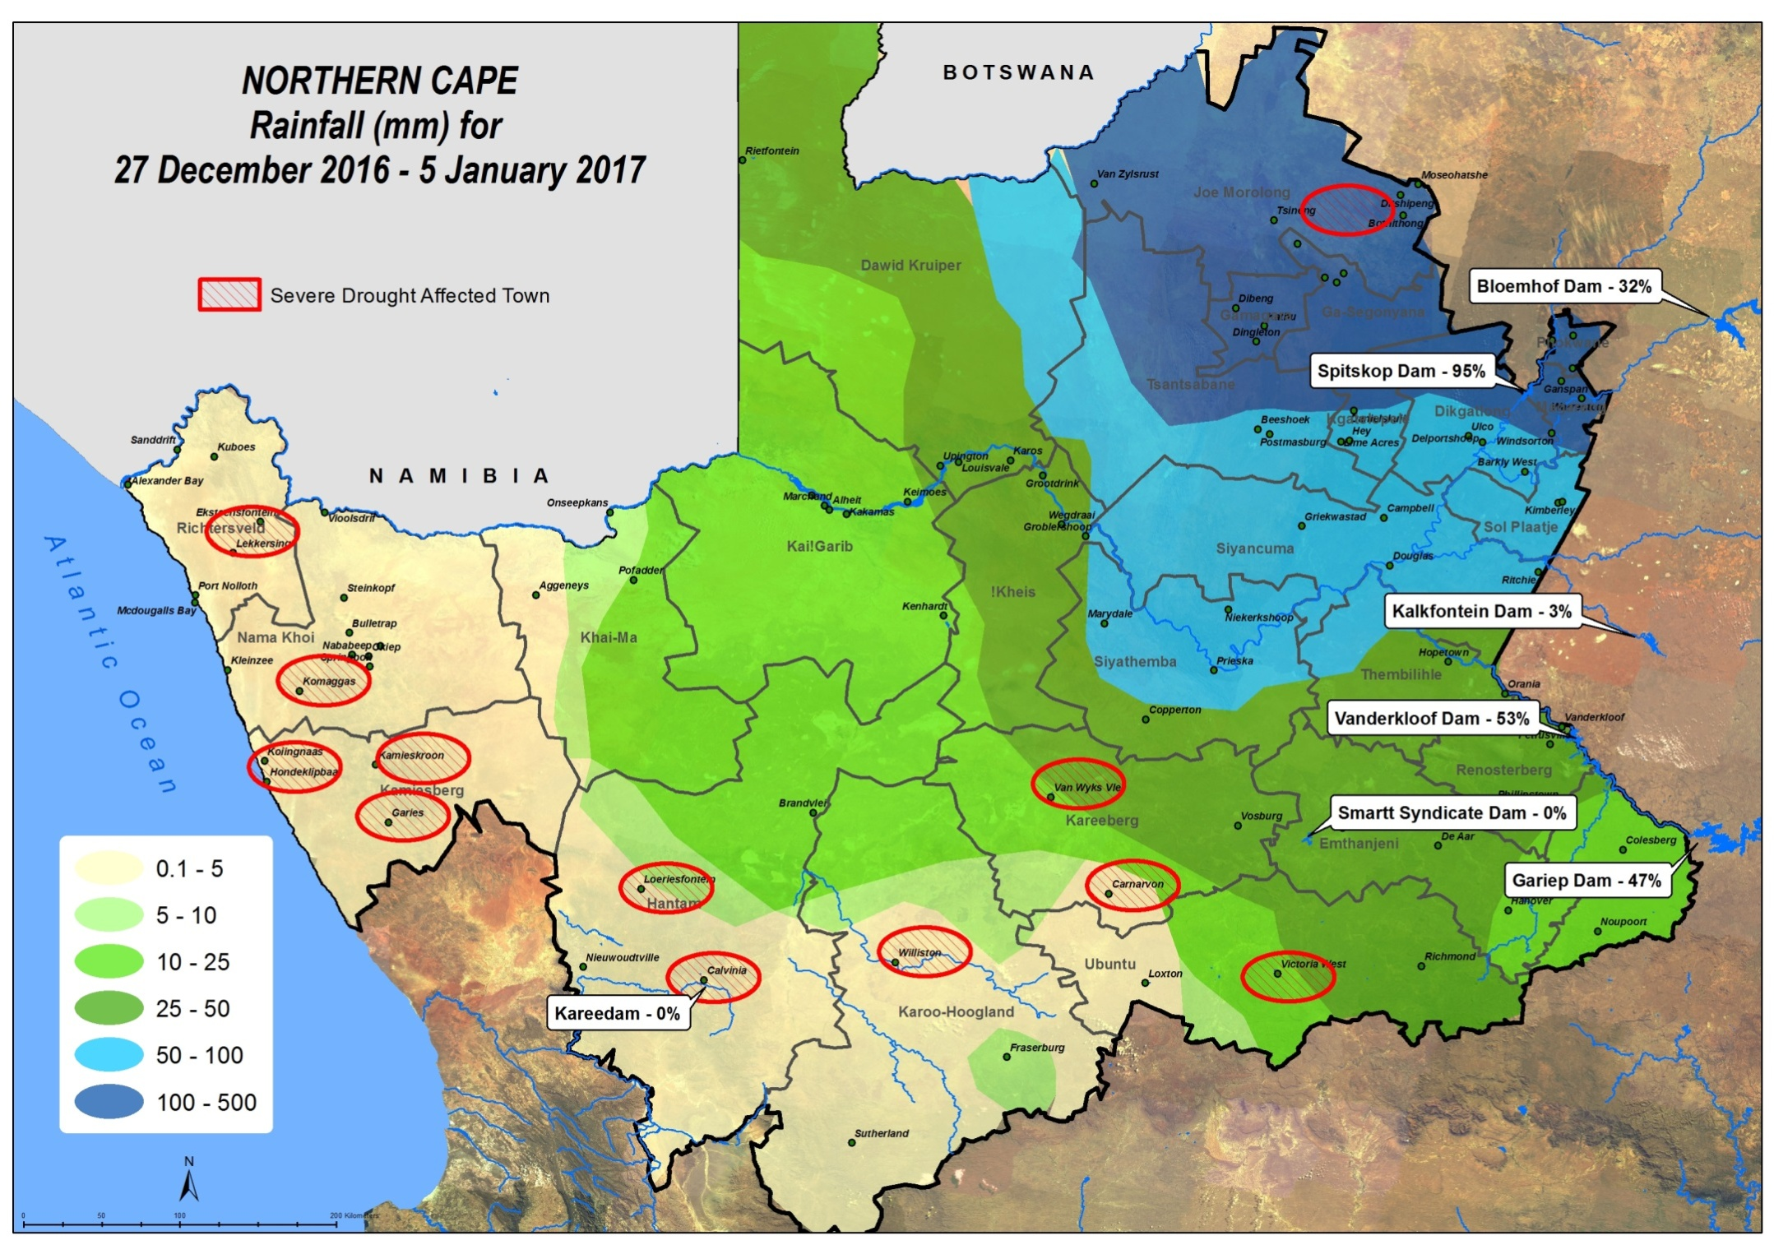

Slide 43
Northern Cape
Despite the good rainfall during December 2016 and January 2017, the drought status remains unchanged.
The mid summer rainfall has not made any difference to the Western parts of the Northern Cape as can be seen on the map on the next slide (rainfall decreased substantially fro east to west). Funding is required for short term solutions such as groundwater source development, small scale desalination where water quality is not acceptable and the carting of water by tanker.
The most severe drought effected towns are in the Namakwa, Pixley ka Seme and John Toala Geatsewe District Municipality, In total 11 towns (Calvinia, Loeriesfontein, Williston, Spoegrivier, Klipfontein, Eksteenfontein, Lekkersing, Van Wyksvlei, Laxey, KiloKilo, Metsimatsi Wyk 7).
All towns are depended on groundwater with the exception of Calvinia which is also supplied by Karee Dam which is currently empty, they now are having to rely on water carted by tanker, the tanker runs are also very long (average round trip is approximately 120 km)
All towns are managed through strict water restrictions.

Slide 44
North West

Slide 45
North West
Crocodile West system: 6 dams serving mainly Tshwane, Madibeng and Rustenberg an decrease of 1.9% to 96.2%. System was at 74.1% at the same time last year.
While dam levels have improved in North West, water supplies are still intermittent due to a lack of maintenance leading to operational failures;
At Swartruggens the dam is now 100%, but the municipality were not able to bring the Water Treatment works back into operation, Magalies Water have been deployed to assist the Municipality, took 3 weeks to re-instate the system
Areas still requiring support: Ngaka Modiri Molema (Tswaing, Ditsobotla, Mahikeng, Ramotshere) and Dr Ruth Mompati (Mamusa Schwartezreineke) Wentzel Dam empty and borehole yields down. Both DM’s do not have funds
In many Municipalities the operators operating Water and Waste Water Treatment works are poorly trained.
The DWS has decreased the number of tankers in operation from 30 to 15.

Slide 46
Western Cape

Slide 47
Western Cape
Cape Town Dams System: 6 dams serving mainly City of Cape Town (CoC): this week decreased by 1.6% to 36.9%. The system was at 45% at the same time last year, there is a slight decrease in the rate of fall from 1.8% the previous week. The Voelvlei dam down 2.2% to 39.8%. The Berg River Dam down 2% to 45.8%. The Theewaterskloof down by 1.8% to 31.8%. The 20% restrictions for domestic and 30% for agriculture in place for the Cape town System. Cape Town have now introduced level 3B restrictions to meet the target currently just 8Ml/day short of target. Agriculture are reducing their consumption by 20% per month through to August to achieve the target.
Concerns circulating on Social Media that CoC only have 100 days water available, this is not true:
the System Operating Forum met in November 2016 and based on the current operating rule for restrictions the system would only be violated in Nov 2022, we do a further system re-run in November 2017. This assumes that all users will implement restrictions as required.
On 13 February 2017 the CoC announced in a media statement that they are now lowering their target from 800 million litres to 700 million litres for collective water use per day.
This they have decided to do because of the current rate of draw down on the dams.

Slide 48
IMPACT ON AGRICULTURE

Slide 49
Impact of Drought on Agriculture
The National Agricultural Marketing Council (NAMC) constituted a committee in terms of Section 7 of the Marketing and Agricultural Products Act (Act 47 of 1996) to advise the Minister on the impact of the drought and implementation of drought response measures.
Some of the findings of the Section 7 Committee are:
The Impact of the drought has been severe over all agricultural sub-sectors ( grains, oilseeds, red meat, sugar and fruits and nuts);
Production has dropped across all sectors and farm incomes have been affected;
Grain farmers in the maize producing areas of Free State and North West the most affected;
The impact has been significant on poor and vulnerable households and individuals;
The Consumer Price Index (CPI) for food and non-alcoholic beverages has breached the upper band of the Reserve Bank inflation target, while this may be in part due to currency weakening, a large part is due to the drought;
Rising food prices affect mainly the poor, which is bad from a food security perspective;
The drought has had catastrophic impact on grazing and fodder production, grazing conditions have reduced significantly and will take some time to recover;
Government’s drought relief programme has played a role in saving some jobs which could have been lost due to drought;
Many farmers continue to struggle to service debt and some businesses may even close.

Slide 50
FUNDING EXPENDED: AGRICULTURE
Funding coordinated by NDMC : AGRICULTURAL SECTOR = R212m
Province | Amount | Status | Farmers Assisted
Eastern Cape | R29 million | Implementation ongoing. Delivery of Lucerne stands at 2629.54 tons | Distribution ongoing. Verification of farmers assisted to date in progress
Free State | R31 million | Implementation ongoing. Delivery of drought pellets is at 49% or 43 591 bags delivered | Distribution ongoing. A total of 1459 farmers assisted to date
Kwa Zulu-Natal | R23 million | Implementation ongoing. Delivery drought pellets is at 16470 bags delivered | Distribution ongoing. Verification of farmers assisted to date in progress

Slide 51
FUNDING EXPENDED: AGRICULTURE
Funding coordinated by NDMC : AGRICULTURAL SECTOR
Province | Amount | Status | Farmers Assisted
Limpopo | R28 million | Implementation halted, due to sluggish implementation contracts of two Service Providers terminated. Delivery of drought pellets stands at 14% or 14 973 bags delivered. Three(3) Service Providers appointed, implementation to commence on the 6 February 2017 | A total of 168 farmers assisted to date.
Northern Cape | R25 million | The Province has requested to implement through a voucher system. Management decision pending

Slide 52
FUNDING EXPENDED: AGRICULTURE
Funding coordinated by NDMC : AGRICULTURAL SECTOR
Province | Amount | Status | Farmers Assisted
Mpumalanga | R26 million | Implementation ongoing. Delivery of drought pellets and mollasses is at 40% or 38 822 bags delivered(pellets & mollasses) | Distribution ongoing. Verification of farmers assisted to date in progress
North West | R38 million | Implementation ongoing. Delivery of drought pellets is at 72% or 110 224 of bags delivered | Distribution ongoing. A total of 8925 farmers assisted to date
Western Cape | R12 million | Implementation ongoing complete. Delivery of drought pellets stands at 100% or 37282 bags delivered | Distribution ongoing. A total of 227 farmers assisted to date.

Slide 53
Conclusion

Slide 54
Conclusion
Although rains are still forecasted in the short term, it is unlikely to be enough for dams to recover fully.
Longer term forecasts indicate not sufficiently above average summer rainfall to support adequate recovery before the winter sets in.
Although SAWS outlook seasonal forecast favours above-normal rainfall for the remaining summer season over most parts of the country, though with reduced likelihood and increased uncertainty compared to previous predictions
Current observations show a gradual decay of the weak La Nina state to neutral ENSO state as expected, this may cast substantial uncertainty on the prediction of rainfall and temperature conditions in the country.
We therefore need to continue to intensify efforts of enforcing water restrictions to stretch available water supplies.

Slide 55
THANK YOU!

