Slide 1
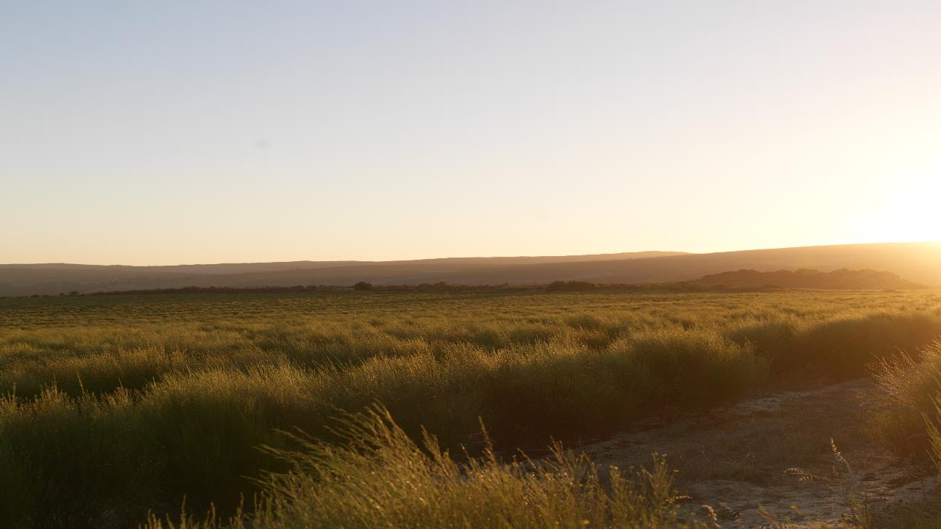
IKS Bill: Public Hearing
25 January 2017

Slide 2
South African Rooibos Council - SARC
The South African Rooibos Council is an independent organization, responsibly promoting Rooibos and its attributes to the consumer and protecting the interests of the rooibos consumer and SARC stakeholders supported by effected research and communication.
SARC supports the need for better co-ordination between government departments, and between government departments and the private sector, with regard to the protection and management of the Indigenous Knowledge.
With the above in mind, SARC is broadly supportive of the IKS Bill and our comments below must be considered in this context.

Slide 3
Three broad areas of concern:
The competing jurisdictional responsibility when the IKS Bill is considered in the context of other legislation and the extra-territorial application of the IKS Bill.
Interpretation and effect of various sections and clauses.
Issues relating to the committees and offices which the IKS Bill seeks to establish.

Slide 4
1. Competing jurisdictional responsibility
Conflict with other legislation
Section 32 does not alter the protection afforded in the Intellectual Property Law Amendment Bill.
The Bill does not state how protection of IKS rights are to co-exist with other intellectual property rights
Trans-border application
The Bill applies to all persons in SA. Persons in South Africa may be prevented from using Indigenous Knowledge while access to such knowledge of persons in other jurisdictions remains unimpeded

Slide 5
2. Interpretation of Sections and clauses
Meaning of Indigenous Knowledge
The definition is vague and has been drafted widely to attempt to capture a wide range of knowledge.
No guidance is given on determining assimilation of IK in the community and this will most likely be a judgment call by the authority which will create uncertainty
Registered Indigenous Knowledge
Section 2 and the limitation to registered Indigenous Knowledge is at odds with Chapter 4 which does not make reference to Indigenous Knowledge having to be registered in order to attract such protection.
It is not clear whether the intention of the legislature is to protect registered Indigenous Knowledge or all Indigenous Knowledge.

Slide 6
2. Interpretation of Sections and clauses
Eligibility and protection
The eligibility criteria in Section 11 are vague and largely subjective and it is uncertain how this will be tested by the authorities.
The vague language would make it difficult to determine when IK ceases to meet such criteria and fall into the public domain as stated in the Bill.
Registration of Indigenous Knowledge
The IKS Bill does not detail the process and mechanism for registration of IK and how such process will be managed, recorded and accessed. The IKS Bill only states that NIKSO may determine such process. It is suggested that a chapter on this process is included.
While the IKS Bill does make provision for publication of registration granted, it does not provide for opposition to be made to an application for registration.

Slide 7
2. Interpretation of Sections and clauses
Rights conferred on holders of IK
The Bill provides for very little oversight over the trustee who holds the Indigenous Knowledge in trust on behalf of the indigenous community and does little to ensure that such a trustee will act in the best interests of the larger indigenous community. The lack of oversight coupled with the economic benefits that could accrue may result in abuse.
There can be multiple claims of ownership of rights, which if recognised may result in conflict between the claimant communities.
The IKS Bill seeks to confer the "exclusive" economic benefit to the holder of the Indigenous Knowledge. These rights are extremely wide and can have financial consequences for the Rooibos tea industry as this may impact on the relative bargaining powers of the communities in respect of benefit sharing agreements.

Slide 8
2. Interpretation of Sections and clauses
Licence to use
It appears that entering into of a benefit-sharing agreement with the indigenous community in terms of NEMBA would not suffice to meet the requirement of having a benefit sharing agreement in terms of the IKS Bill
A third party whose activities may constitute biotrade or bioprospecting AND the use of IK will have to enter into two separate benefit-sharing agreements. This could result in a third party having to pay benefit twice for the same activity and should be addressed in the IKS Bill
NIKSO has the absolute discretion to grant such licences, it is granted inordinate bargaining power against applicants for licences, as well the determination of royalties payable by a licence holder. There should be criteria for determining the maximum threshold for royalties

Slide 9
2. Interpretation of Sections and clauses
Contradictions with IKS Bill
Section 13 requires that a user of Indigenous Knowledge enters into a benefit sharing agreement with the holder of the Indigenous Knowledge. However, Section 26 requires that any person who intends to use Indigenous Knowledge for commercial purposes must enter into a benefit sharing agreement with NIKSO. This should be amended to provide certainty.
The IKS Bill provides for the accreditation of "Indigenous Knowledge Practitioners" by NIKSO. The IKS Bill requires that such a person makes application "in the prescribed manner", however it fails to provide guidance and states only that "NIKSO must make recommendations to the Minister regarding the norms and standards for accreditation".

Slide 10
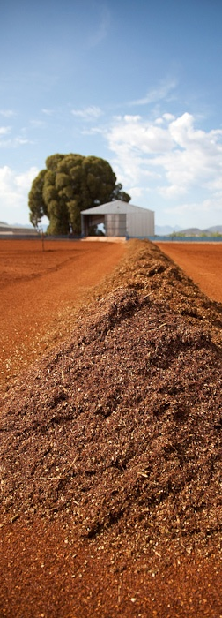
3. Committees and offices
National Indigenous Knowledge Systems Office (NIKSO)
The functions of NIKSO as defined in the Bill are wide and lacks guidance for implementation
The head of NIKSO is appointed by the Minister and subject to directions and instruction issued by the Minister or DG
In cases where NIKSO act as custodian of IK and where the ownership of it vests in NIKSO, there is no specification how the funds accrued from such ownership/benefit shall be allocated and utilised and is thus susceptible to abuse.

Slide 11
3. Committees and offices
Advisory Panel and Dispute Resolution Committee
There is no provision for private sector participation on the Advisory Panel & “specialists in the discipline of practice” is not defined
The Dispute Resolution Committee has unconstrained legislative power
No provision for how decisions will be made by the committees. Instead, the Bill permits the Minister to determine the procedures. It is therefore unclear whether a consensus or a majority will be required for decisions
There is no guidance in the IKS Bill regarding the qualification criteria or number of persons to be appointed as members of the Dispute Resolution Committee, the Minister can appoint any person

Slide 12
3. Committees and offices
Offences and Penalties
The Dispute Resolution Committee may determine any sanction for not complying with the Bill and this will likely culminate in the arbitrary and irrational determination of penalties.
The IKS Bill current include different penalties for: 1) use of IK without authorisation, or the false claim to be a certified IK Practitioner (R30 000 fine and/or 1 year imprisonment) and 2) interference with an official in the performance of duties (R30 000 fine and/or 3 years imprisonment). The IKS Bill should be amended to provide that the fine should be up to a maximum of R30 000 and the imprisonment for interference with an official should be reduced to 1 year to bring it into line with the other penalties

Slide 13
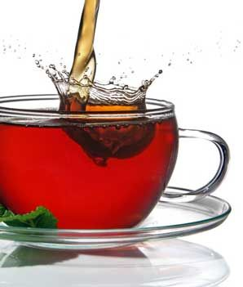
Conclusion
As stated above SARC is broadly supportive of the IKS Bill.
However, in our view, the IKS Bill contains some flaws which we have highlighted. These flaws can be remedied through a careful and considered redrafting. We implore the drafters of the IKS Bill to undertake this task.
We are willing to address any questions which this submission may prompt and to amplify any arguments we have raised.

Slide 14
Thank you
We would like to thank the Portfolio Committee for Science and Technology for giving us this opportunity to submit written comments and to present a summary of those comments today.

