Slide 1

STATUS OF THE SOUTH AFRICAN MARINE
FISHERY RESOURCES
2016

Slide 2
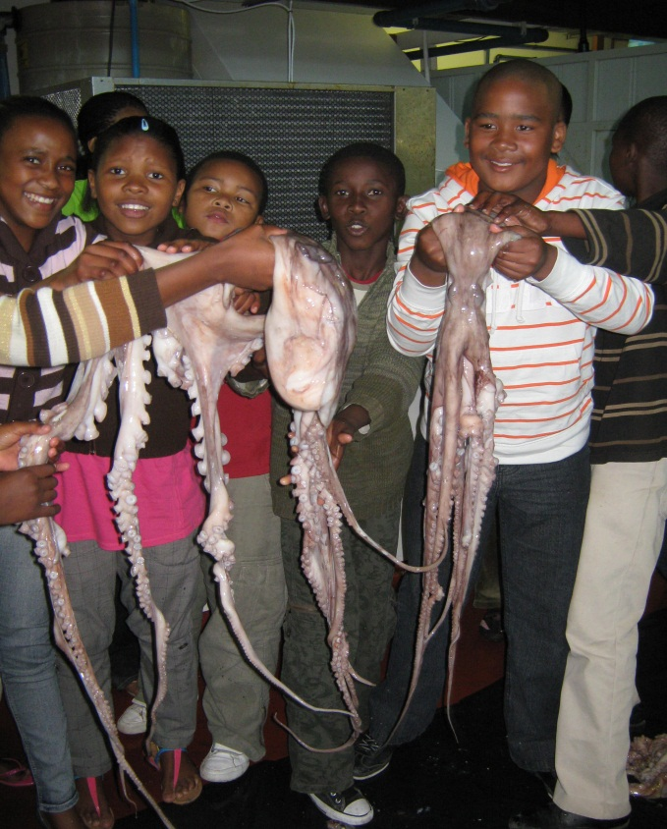
INTRODUCTION
This report is a summary of the collective effort of the research team in the Fisheries Branch of the Department of Agriculture, Forestry and Fisheries
The Status of the South African Marine Fisheries
Resources Report covers all of the managed
fishery resources
For each resource it provides:
- A quick-view assessment of resource status
- An introduction to the resource
- Information on history and management
- Details of research and monitoring
- Updates of current status and future projections
Mandela Day Celebrations at the
Seapoint Research Aquarium

Slide 3
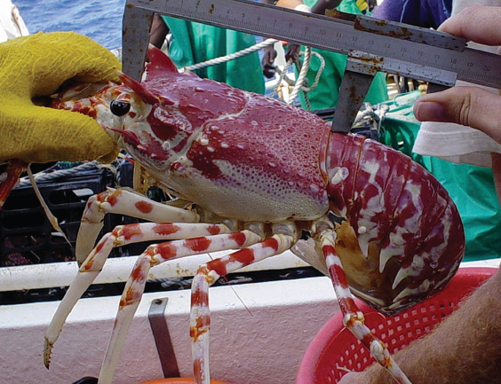
TODAY’S PRESENTATION
Presents a summary of the status of the marine fishery resources as a whole
Provides a detailed overview from
the report on key resources:
- Cape hakes
- Abalone
- West Coast rock lobster
A South Coast rock lobster has its vital statistics recorded
3

Slide 4
SUMMARY
Abalone
St Joseph shark
Yellowfin tuna
(Ind.)
Smoothhound shark
Harders
Oysters (S. Cape)
Blue shark
Elf
White steenbras
Heavy
Squid
Soupfin shark
Longfin mako
shark
The stock status gives an indication of the current status, resulting from past fishing activities
Fishing pressure describes the current level of fishing on resource
Of the 49 stocks assessed for the 2016 report:
In trouble = 50% (serious trouble =28%; moderate trouble = 22%)
Healthy & optimally utilized = 37%
Under utilized & unsure = 13%
Albacore (Ind.)
Bigeye tuna (Ind.)
Yellowfin tuna
(Atl.)
Southern bluefin
tuna (Ind. & Atl.)
Deep-water hake
Silver kob
Sardine
Horse mackerel
West Coast
rock lobster
Oysters (KZN)
Shallow-water
hake
Yellowtail (line & net)
Snoek
Swordfish (Atl.)
Carpenter
Prawns (shallow-
water)
Optimal
Slinger
Prawns (deep-water)
Albacore (Atl.)
Bigeye tuna (Atl.)
Patagonian
toothfish
Swordfish (Ind.)
Kelp
South Coast
rock lobster
FISHING PRESSURE
Anchovy
Oceanic white-tip
shark
Agulhas sole
Redeye
Light
Seaweed (non-kelp)
Great hammerhead
shark
Hottentot seabream
Red steenbras
Unknown
White mussel
Seventy-four
Unknown
Abundant
Optimal
Depleted
Heavily
depleted
STOCK STATUS

Slide 5
COMPARISON WITH TWO YEARS BEFORE – gains and losses
2016
2014
2014
2016
2014
2016
2016
2014
2014
2016

Slide 6
WHY THE CHANGES BETWEEN YEARS?
Deterioration in the status of a fish stock:
Squid – status has deteriorated for unknown (perhaps environmental) reasons, but insufficient data are available to perform accurate assessments or determine probable causes, so much uncertainty remains
Indian Ocean yellowfin tuna – Indian Ocean Tuna Commission (IOTC) advises that status has deteriorated due to unsustainable fishing pressure and proposes 10-15% reduction in effort
Indian Ocean bigeye tuna – IOTC advises that status has deteriorated due to unsustainable fishing pressure
Improvements in the status of a fish stock:
Deep-water hake – has improved in response to the recovery plan developed by the Demersal Scientific Working Group and implemented by the Fisheries Management Branch over the past years
Anchovy – has shown a natural increase in response to recent good recruitment events
Linefish: carpenter, hottentot seabream & slinger have improved

Slide 7
WHY THE CHANGES BETWEEN YEARS? Continued…
Improvements in the perception of stock status (due to improved data and assessments):
Hottentot seabream (linefish) – improved assessment by Linefish Section
Carpenter (linefish) – improved assessment by Linefish Section
Slinger (linefish) – improved assessment by Linefish Section
Yellowtail (linefish) – improved assessment by Linefish Section
Indian Ocean swordfish – improved data and assessment by IOTC
Indian Ocean albacore – improved data and assessment by IOTC
Atlantic Ocean albacore – improved data and assessment by International Convention for the Conservation of Atlantic Tunas (ICCAT)

Slide 8
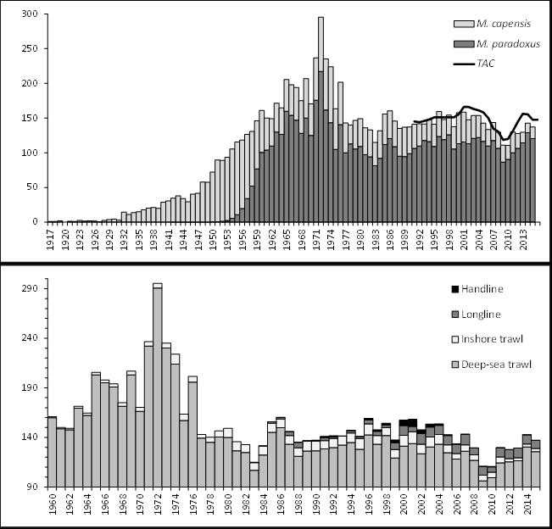
CAPE HAKES
Fishery catches shallow-
and deep-water hakes
together
Caught by trawl (inshore
& offshore), longline
and handline
Value equals that of all
other SA marine fisheries
combined
Deep-sea trawl is the only
South African fishery
certified by the Marine
Stewardship Council
and was recently re-
certified by the MSC

Slide 9
CAPE HAKES …..
2006 assessments indicated no problems with shallow-water hake, but indicated that deep-water hake was over-exploited
A recovery plan in the form of an Operational Management Procedure
(OMP) aimed at recovering biomass of deep-water hake was implemented
TACs were substantially reduced for a few years (2007-2009), after which the resource responded positively, and recovered faster than had been anticipated
As a result catch rates have increased, as have TACs
Current management aims to keep the resource around the Maximum Sustainable Yield Level (MSYL)

Slide 10
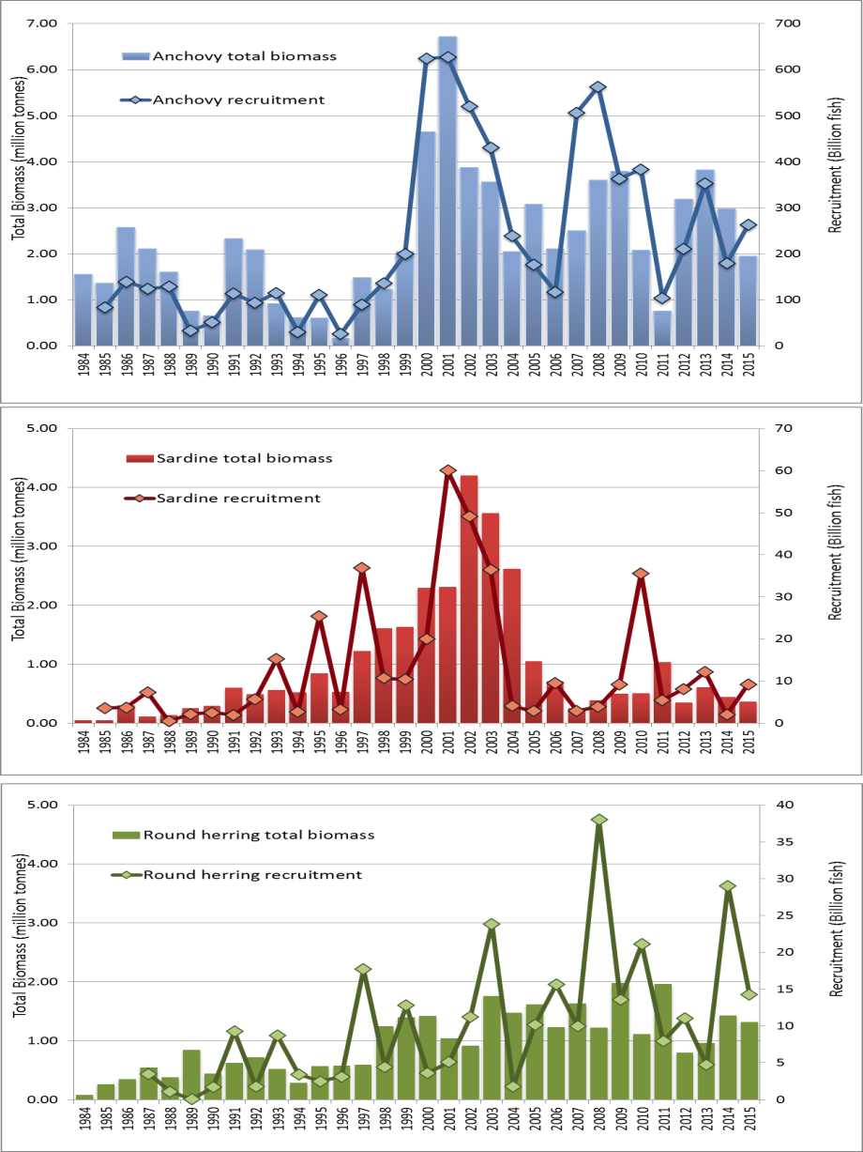
PELAGIC - TOTAL BIOMASS AND RECRUITMENT
Time-series showing annual estimates of total biomass (histograms) and recruitment (circles and lines) from hydro-acoustic surveys, 1984-2015
Anchovy: total biomass during November 2015 survey estimated at 1.9 million tonnes; slightly below long-term average of 2.28 million tonnes. Recent recruitments good
Sardine: total biomass during November 2015 survey estimated at 363 000 tonnes; well below the long-term average of 968 700 tonnes and following 5 successive years of poor recruitment
Redeye round herring: total biomass during November 2015 survey estimated at 1.3 million tonnes; above long-term average of 967 200 tonnes. Recent recruitments very good.

Slide 11
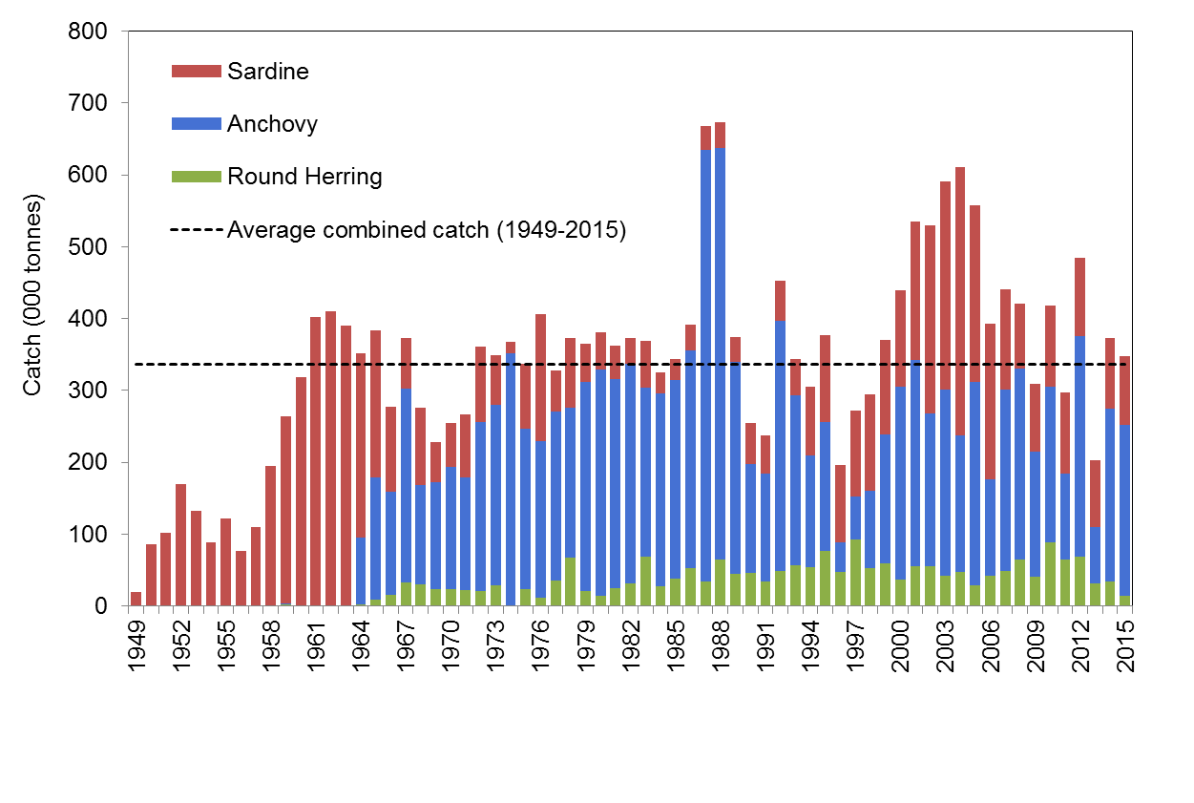
PELAGIC FISH ANNUAL CATCHES
Catches of sardine, anchovy and west coast round herring by the small pelagic fishery, 1949-2015; landings dominated by anchovy

Slide 12
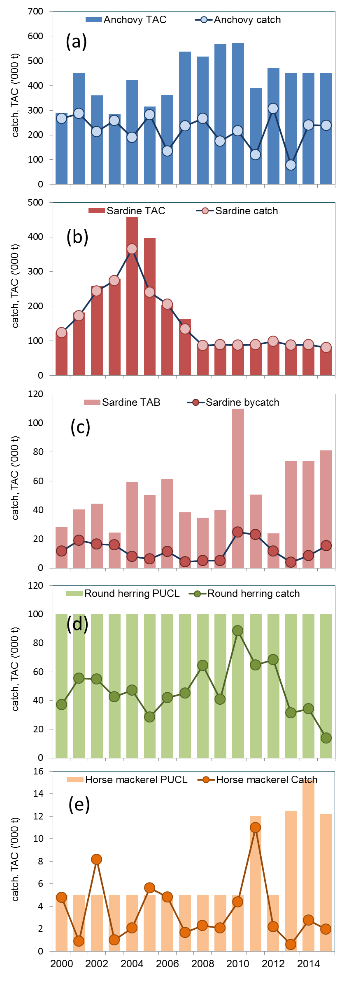
PELGIC FISH ANNUAL TACs AND CATCHES
Anchovy TAC again under-caught in 2015; industry claim changes in anchovy behaviour have reduced catchability and new air pollution legislation has constrained processing
Sardine TAC fully caught in 2015
Redeye round herring PUCL substantially under-caught in 2015 (fish availability, preference for anchovy)
2016 TACs and catches to 9th November 2016:
Anchovy: TAC = 450 000t; catch = 261 407t
Sardine: TAC = 66 375t (low level due to low sardine biomass); catch = 61 282t
Redeye round herring: PUCL = 100 000t; catch = 53 599t

Slide 13
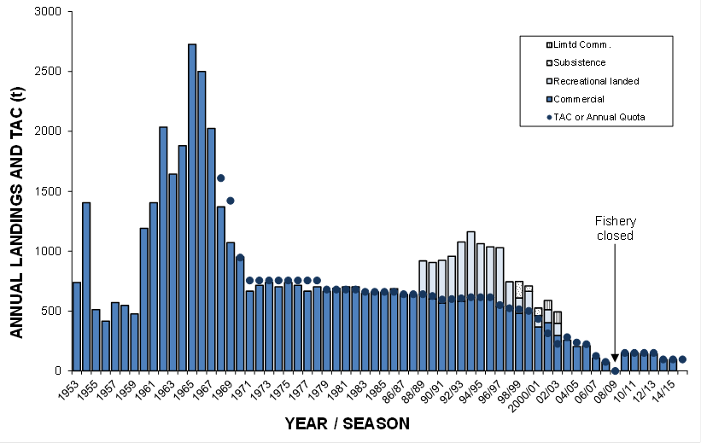
ABALONE
Resource has suffered serious decline despite best efforts at management
(e.g. closure of recreational
fishery, drastic TAC reductions,
area closures, TURF system)
The recreational fishery was
closed in 2003
The commercial fishery was
closed in 2008
Commercial fishery was
conditionally re-opened in
2010
Total allowable catch (TAC) and recorded (legal) annual landings for the abalone fishery from 1953 to 2015/2016. Landings for the recreational sector are only available since 1988/1989. Note that the substantial recent illegal catches are not shown.

Slide 14
ABALONE ….. Zones A & B (Gansbaai to Buffeljags)
Assessments indicate that the resource continues to decline
in these Zones
Projections show that the resource will continue to decline at the current rate of harvesting
The major contributor to this decline is illegal harvesting
Projections further indicate recovery is possible if major reductions in illegal harvesting can be achieved
Total (inshore + offshore) spawning biomass projections for Zones A and B. The 20-year projections shown after the vertical line represent four different scenarios for resource status under future commercial and poaching catches. Unless a zero amount is assigned, future poaching levels are assumed to remain at the current estimated level (average of 2015 and 2016 estimates) and future commercial catches in each of these two zones are set to the current TAC of 20 t. The bottom plots zoom in on a shorter period to be able to distinguish the curves more clearly. In each plot, the required reduction in poaching necessary to keep the resource stable at its present level under the current TAC is also shown, with the required reduction indicated in the legend

Slide 15
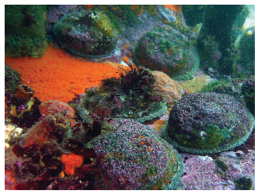
ABALONE ….. Other Zones
Zones C& D (Hangklip to Hermanus)
- The resource is continuing to decline due to poaching
- The incursion of rock lobsters since the early 1990s has caused an ecosystem shift,
hampering recruitment of young abalone and
compromising the ability of the resource to
recover in these Zones
- Zero TACs are currently being maintained in
these zones
Zones E, F & G (West Coast)
- Resource indicators suggest no reason to change catch allocations in these zones
- Estimates of possible stabilisation in poaching
over the last 2 years were noted in these zones
- The natural productivity and reproduction
are low here, compromising the ability of the resource to recover in these zones
Abalone in their natural environment

Slide 16
WEST COAST ROCK LOBSTER
The fishery generates around R260m per year, and employs about 4 200 people
The fishery has traditionally focused on the West Coast, but resource shifts in the 1990s resulted in three new areas being opened up East of Cape Hangklip
The fishery consists of the following sectors:
- Offshore commercial (traps)
- Inshore commercial (hoop-nets)
- Interim relief
- Recreational
West Coast rock
lobster fishing zones

Slide 17
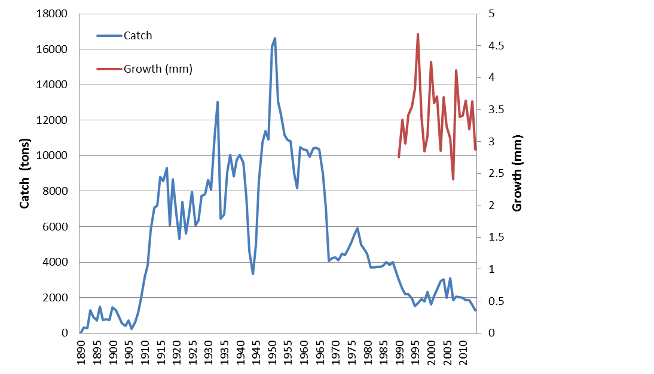
WEST COAST ROCK LOBSTER …..
Declines in catches since the 1950s-1960s have had a number of causes, including:
- Changes in fishing methods - Stricter control of catches
- Declines in resource
abundance
- Reduced growth rates
- Environmental changes
Historical catches of West Coast rock lobster, with the associated trend in growth indicated for the period post-1960.

Slide 18
WEST COAST ROCK LOBSTER …..
The resource is currently severely depleted. It is estimated that the resource is currently at 2.5% of pre-fished levels
The current recovery plan aims to recover the resource by 35% by 2021, i.e. to 4.8% of pre-fished levels by 2021
The global TAC for the
2015/16 season was set at
1924.5 t in line with the
recovery plan.
A catch of West Coast rock lobster

Slide 19
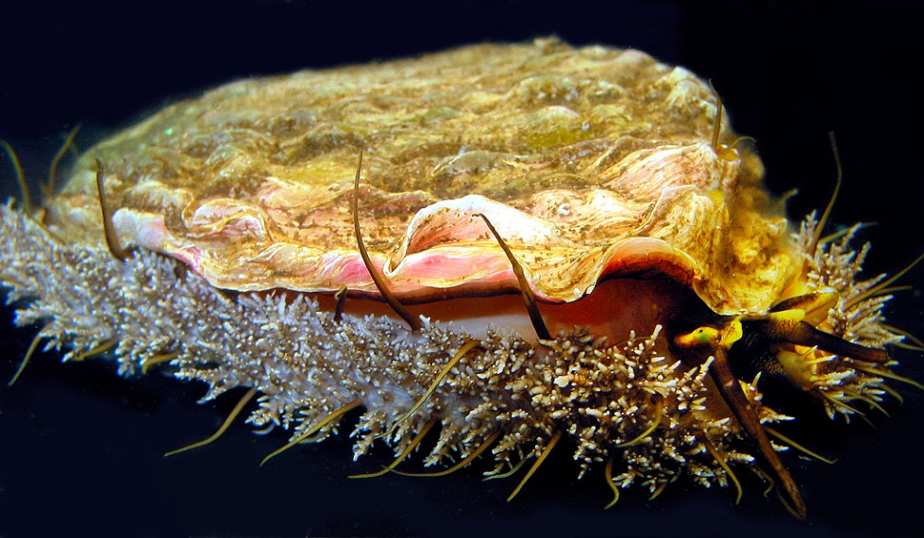
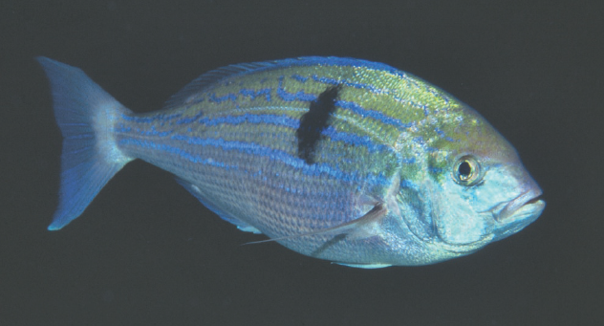
CONCLUDING – THE BAD NEWS
Many of our key marine fishery resources have been over-fished in the past
In particular, our nearshore resources are under extreme pressure
Our resources are therefore impoverished and catches are often far less than they could be

Slide 20
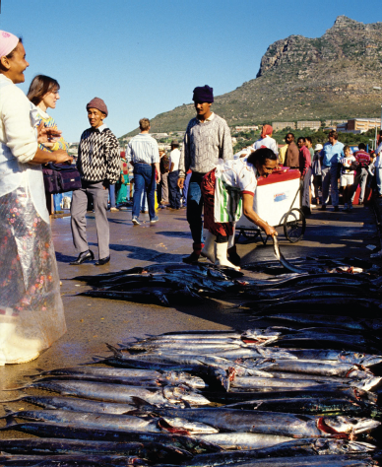
CONCLUDING – THE GOOD NEWS
Wild fish stocks are not doomed to dwindle down to nothing
With wise management, something can be and is being done
Our experience (for example with deep-water hake) has shown us that recovery plans can provide positive results
This can lead to greater productivity of fish stocks and substantially larger catches of certain resources
By implementing resource recovery plans, we can achieve gains that will make a significant positive contribution to food security and alleviating coastal poverty
A good snoek catch brings smiles to the faces of fisherfolk in the Western Cape

Slide 21
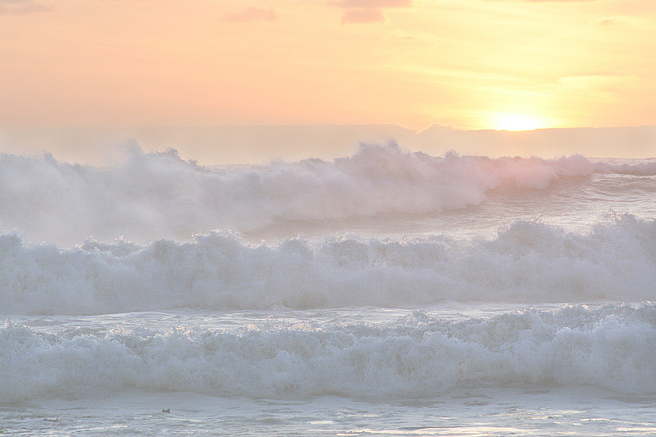
THANK YOU

