Slide 1
Briefing to the PC: Trade and Industry on cases of the National Consumer Tribunal
Presented by:
Prof Bonke Dumisa
Deputy Chairperson &
Ms Marelize Bosch,
COO
Date: 8 November 2016

Slide 2
Overview - Acronyms
CMS Case Management System
RDS: Remote Desktop Service
NCT: National Consumer Tribunal /
Tribunal
NCR: National Credit Regulator
NCC: National Consumer Commission
NCA/NCAA: National Credit Act , Act 24 of 2005 and National Credit Amendment Act
CPA: Consumer Protection Act
ICT: Information Communication Technology
DSS: Decision Support System
PC: Prohibited Conduct
2 of 38

Slide 3
Overview - Glossary of Terminology
Allocation:
To allocate a matter to a single member or three member Tribunal panel for hearing as required by the NCA.
Close of pleadings:
Pleadings is open for a set period of time after complete filing to allow the parties to file an answering and replying affidavit. After this period pleadings close and the matter is ready to be allocated for a hearing.
Condonation application:
If a party fails to follow the Tribunal rules (for example file an answering affidavit outside of the permitted time period), such a party must apply to the Tribunal to condone non-compliance with its Rules. If the non-compliance is not condoned, the step will be irregular and disregarded.
3 of 38

Slide 4
Overview - Glossary of Terminology cont.
Interlocutory proceedings / applications (includes condonation applications)
These are proceedings that deal with the rights of the parties between the commencement of the action and its final determination for example -
Apply for an extension of time for submitting pleadings
Amendments to pleadings
Additional answering and replying affidavits
Seek directions regarding the conduct of the case
Compel the other party to comply with the rules or directions or
Apply for interim relief or remedy etc.
4 of 38

Slide 5
Overview - Glossary of Terminology
Complete filing
A term which means that all the filing requirements for a specific application, as set out in the Tribunal rules, have been met. This notice also signals that pleadings are open and that the Respondent may file an answering affidavit.
Consequent to the NCA Rule changes, assessments for complete / incomplete filings are no longer required – this reduces resource requirements and will require a change in the NCT’s APP KPI index
NON DRA Assessments – We will continue with these, due to costs and complexity if not done at outset. A guidance note will be prepared for unrepresented parties in relation to filing and hearings at the Tribunal.
DRA Assessments - Done at motion court together with the adjudication process.
5 of 38

Slide 6
Glossary of Terminology
DRA
A Debt re-arrangement application is brought by a Debt Counselor on behalf of a consumer to re-arrange the consumer’s credit agreement obligations as agreed with the consumer’s credit providers.
Though these are agreements entered into between the DCs and credit providers on behalf of consumers the NCT interrogates these settlements carefully as they may contain –
illegal interest rates
Instances where the consumer has in fact not consented to the DRA
Amounts to be repaid that are in excess of what the consumer can afford
Not all the consumers’ creditors’ consented to the DRA
Repayment terms that are longer than the reasonable work life of the consumer
Repayment agreements do not settle the debts
Insufficient provision for consumers’ living expenses
Unaffordable repayments
6 of 38

Slide 7
Glossary of Terminology
Non-DRA
Non-debt re-arrangement application. All other applications which may be heard by the Tribunal, excluding DRA’s. These applications in most instances require three member Tribunal members and a formal hearing.
Approximately 53 Prohibited Conduct types and 34 applications in terms of NCA, for example referral of prohibited conduct by Regulator i.e reckless credit granting, failure to do affordability assessments, charging illegal interest rates, review of sale of goods, resolving disputed entries on statements or cases of prohibited conduct referred directly to the Tribunal by a consumer after receipt of a non-referral notice.
7 of 38

Slide 8
Glossary of Terminology
Non-DRA
Approximately 99 Prohibited Conduct applications in terms of the CPA for example issues of quality of services and goods, warranties offered on repaired goods;
These are often complex matters. Involving new legislation without guiding precedents.
All instances heard to date were brought to the Tribunal as a result of non-referral notices being issued to Consumers as opposed to matters referred by the Regulator.
8 of 38

Slide 9
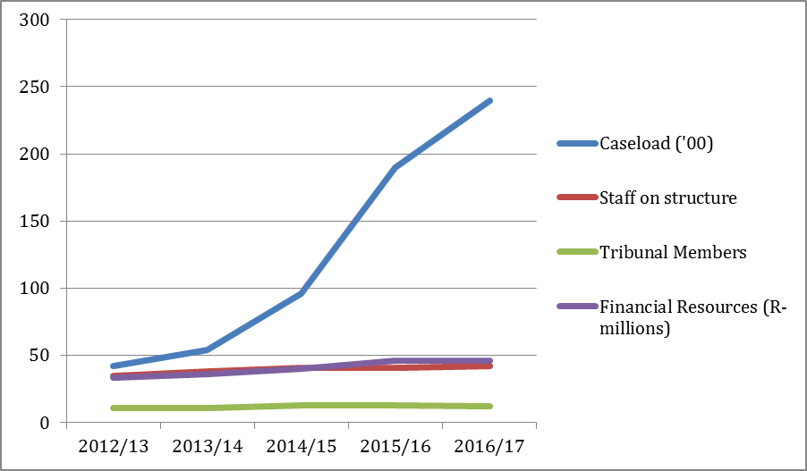
The Tribunal’s Caseload vis-à-vis other resources
9 of 38
Notes:
The NCT received 24 446 cases from 1 April 2016 up to and including 21 October 2016. This is already 3,349 cases more than the 19,097 cases received during the entire 2015/16. This is a 99,16% increase on the 9,589 cases received during 2014/15 and a 254.57% increase on the 5,386 cases received during 2013/14, and 355.45% increase on the 4,193 cases filed during 2012/13. In essence, the caseload of the Tribunal has increased almost fourfold over the immediate past 3 year period. The financial resources of the Tribunal increased by 12.93% on average year-on-year over the same 3-year period and the staff complement of the Tribunal increased with three staff members, from 38 to 41 employees on the structure. The Tribunal members increased from 11 to 13 with the appointment of two full-time members during the 2013/14 FY.

Slide 10
The Tribunal’s Caseload vis-à-vis other resources
The Tribunal received 24,446 cases from 1 April 2016 up to 21 October 2016.
This is 3,349 cases more than the 19,097 cases received during the entire 2015/16.
It therefore appears that the NCT case load will again atleast double.
Our financial resources increased by 12.93% on average year-on-year over the same period.
Our staff complement increased from 41 to 42 employees on the structure.
Our Tribunal members reduced from 13 to 12, with one member resigning.
10 of 38

Slide 11
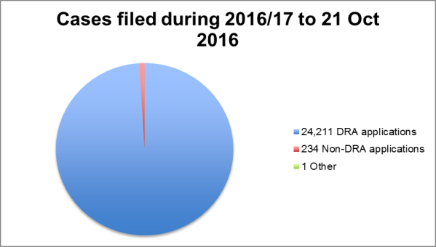
Breakdown on cases filed with the NCT during 2016/17
The 24,446 cases received from 1 April 2016 to 21 October 2016 were as follows :
11 of 38
Notes:
According to the numbers of cases filed. This is not reflective of the time and resources required to manage these two types of cases to finality. Included in the number of Non-DRA applications is 5 duplicate filings.

Slide 12
Filing parties
Applications can be brought by:
National Credit Regulator and National Consumer Commission
Consumers
Service providers
Registrants, including credit bureaus, credit providers, debt counsellors (DRAs), PDAs and ADRs
12 of 38

Slide 13
Non-Debt Re-arrangement matters per Act filed during 2016/17
13 of 38
Notes:
During 2016/17 we received 18 matters in terms of the CPA (2 Regulator referrals and 16 non-referrals) and 219 matters in terms of the NCA (3 Regulator referrals, 5 Non-referrals and 211 Other)

Slide 14
Non-Debt Re-arrangement matters per filing parties filed during 2016/17
14 of 38
Notes:
During 2016/17 we received 3 matters from the NCR all of which relate to prohibited conduct referrals. We received two prohibited conduct referral from the National Consumer Commission.
We received 230 applications from other filing parties. These applications are mostly brought by unrepresented filing parties. We have received 2 matters of failed ADR, 1 review of sale of goods We have received 50 applications for variation or rescission of Tribunal orders (these matters are closely linked to the debt re-arrangement applications), 5 Non-referral applications in terms of the NCA, 16 Non-referral applications in terms of the CPA, 1 application for interim relief, 152 request for a statement and 1 application to resolve a disputed entry on a statement, 1 application for consent after resolution of a dispute by an ADR agent, 1 Application to limit obligations in respect of frivolous, vexatious or unreasonable requests
However 5 matters are duplicates 3 of which had been recorded as rescission applications, 1 as a CPA non Referral and 1 as a NCA non Referral.
Summary 3 NCR Matters, 2 NCC matter, 5 duplicates (filing by other parties), 225 filing by other parties

Slide 15
Current Tribunal Cases
The Tribunal has 22,824 current matters, not yet finalised.
15 of 38
Notes:
The Tribunal currently has 22,824 current matters. These matters can be divided into 22,642 applications for debt re-arrangement orders and 182 non-debt rearrangement matters. Of the 182 Non-DRA matters, 47 were filed before 1 April 2016 and 135 filed after 1 April 2016 up to and including 21 October 2016. As at 21 October 2016 the Tribunal has a total of 22,642 (5,132 filed prior to 1 April 2016) applications for debt re-arrangement orders to adjudicate on.

Slide 16
Finalised Debt Re-arrangements applications within 2016/17
The Tribunal issued 12,032 orders on debt re-arrangement applications during 2016/17 up to 21 October 2016.
Issued through motion courts with resounding success.
Assessment of matters attended to at the motion courts as a service to the parties, and no longer prior to the adjudication process.
The turnaround from date of filing to the issue of an order is 91,4 days
Overall – Our turnaround to finalise debt re-arrangement applications for 2016/17 is 5,13 days from complete filing. We have requested permission to amend this KPI.
Very positive feedback from filing parties in relation to this specific intervention
16 of 38

Slide 17
Finalised Non-DRA applications
213 Non-DRA cases finalised during 2016/17.
100 filed during 2016/17
113 filed before 2016/17
17 of 38

Slide 18
Current Status of NCR Cases
40 Current Matters
43 Matters finalised during 2016/17
FILED PRE 2015/16 |  | 28
CURRENT MATTERS | 12
FINALISED MATTERS | 16
FILED DURING 2015/16 |  | 52
CURRENT MATTERS | 25
FINALISED MATTERS | 27
FILED DURING 2016/17 |  | 3
CURRENT MATTERS | 3
FINALISED MATTERS | 0
Total | 83 | 83
18 of 38

Slide 19
NCR CURRENT MATTERS
FILED BEFORE 2015/16 AND NOT YET FINALISED |  | 12
CONDONATION IN PROCESS | 1
SET DOWN | 1
SET DOWN (PRE-HEARING) | 1
POSTPONED – HELD IN ABEYANCE DUE TO HIGH COURT APPLICATIONS AND LIQUIDATOR APPOINTMENT | 8
JUDGMENT OUTSTANDING | 1
19 of 38

Slide 20
NCR CURRENT MATTERS
FILED DURING 2015/16 |  | 25
PLEADINGS OPEN | 3
CONDONATION IN PROCESS | 4
CANNOT SET DOWN (PARTIES' REQUEST DUE TO HIGH COURT APPLICATIONS ON RELATED MATTERS) | 7
SET DOWN/TO BE SET DOWN (INCL 1 PREHEARING & 2 RULE 16A APPLICATIONS) | 10
JUDGMENT OUTSTANDING | 1
20 of 38

Slide 21
NCR CURRENT MATTERS
FILED DURING 2016/17 |  | 3
CONDONATION | 2
SET DOWN FOR PRE-HEARING | 1
21 of 38

Slide 22
Turnaround on NCR pending / current Cases
Average Turnaround as at 21 October 2016
The turnaround of the 40 current matters from date of filing to 21 October 2016 is 330 days and from close of pleadings is 235 days.
39 of the current 40 matters, have or have had either condonations, amendment applications, postponements, intervention applications.
1 of the 40 matters had no interlocutory applications.
22 of 38

Slide 23
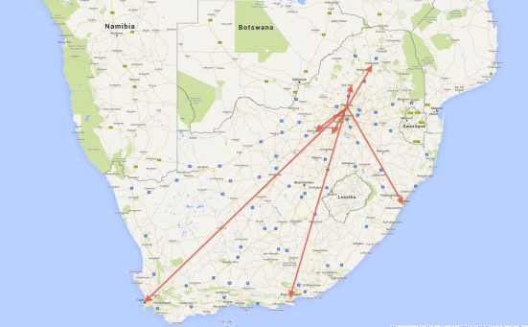
Highlights and Achievements
Motion Court Process/Access
23 of 38

Slide 24
Highlights and Achievements
4th Successive Clean Audit;
Successful automation programme - Indications are that filing parties will take on programme.
Innovation – Through innovation, NCT will be able to deliver on its mandate within its allocated resources
24 of 38

Slide 25
CURRENT SYSTEM IN OPERATION
Case Management
System
Email
Fax
Submit Application
Post
Walk in
Filing Party
Generated case number
Issue
Motion Court
St
Notice of Complete/Incomplete
St
Grant/Refuse/Directive
25 of 38

Slide 26
PROPOSED SYSTEM/ELECTRONIC FILING
Case Management
System
Registration
Payment
Filing Party (External)
NCT Website
Register for CMS access
Payment on Epurse
Upload XML
XML Web service
LAN CONNECTION
Filing Party or Internal staff
Onsite terminals
(self service)
Capture into templates
Case number, Incomplete/complete notices, orders, directives to filing parties sent electronically.
26 of 38

Slide 27
Impact of NCT Decisions
NCT provide redress to Consumers -
directly
confirming debt re-arrangement applications,
ordering refunds,
issuing certificates of prohibited conduct; as well as
indirectly
cancellation of registration of errant credit providers, debt counsellors etc,
creating certainty re interpretation of the legislation by making declarations of prohibited conduct and reviewing decisions of Regulators.
Interdicting prohibited conduct.
27 of 38

Slide 28
Specific NCT Decisions
The NCT has delivered some ground-breaking decisions, which have put significant money back into the pockets of consumers, i.e.
Barko – Decision;
Bornman – Decision;
Lewis – Decision;
NCR v Lightning Cash Loans
In addition, these decisions have shaped the regulatory environment and created binding precedents.
28 of 38

Slide 29
Specific NCT Decisions
The Tribunal has also impacted individual consumers and provided redress on an individual basis, i.e
Hygenique Toilet v NCC – Set aside a compliance notice against a small service provider.
Coertze & Burger v Young – Order a refund for services NOT rendered
Jarvis v Alberante Motors – Order a replacement motor engine
Lazarus v Visco Stone – Order a refund in lieu of replacing defective granite.
29 of 38

Slide 30
Administrative Fines
Administrative penalties serve as a deterrent to prohibited conduct, however must be balanced.
Factors are set out in the legislation and the Tribunal also consider submissions made re employment, business continuity etc.
During 2016/17 the Tribunal issued administrative fines to the value of R995,000 – including settlements.
In total, the Tribunal has issued administrative fines in excess of R7,000,000 to various parties.
The Tribunal orders refunds in terms of matters where refunds are due, however the exact amount is normally determined via an audit which is overseen by the NCR.
30 of 38

Slide 31
NCT average cost per case – actual compared to budget
Components to the cost per case | Actual 2015/16 | Forecast 2016/17 | Budget 2017/18 | Budget 2018/19 | Budget 2019/20
Adjudication costs | 1 540 | 734 | 463 | 355 | 290
Administration costs | 2 302 | 802 | 431 | 260 | 161
Total cost per case | 3 842 | 1 536 | 894 | 615 | 451
31 of 38

Slide 32
NCT Budget
NCT ‘s financial resources in respect of the next MTEF period from 2017/18 to 2019/20 should be sufficient, despite current increased caseload, due to:
Implementation of motion courts;
Hearing more than one Non-DRA matter per day and increasing in number of DRAs per day;
Increase in filing fee (effective from 4 February 2016)
Anticipated future ICT enhancements;
Cost-saving on other line items, i.e. travelling, digitization
Approval of roll-over funds by National Treasury to be used for future operational cost requirements.
32
32 of 38

Slide 33
NCT Budget (continues…)
However, if caseload (being very unpredictable) increase again as experienced in the last number of years, NCT may experience difficulty in achieving its mandate within its allocated budget if the ICT interventions are not as efficient as we predicted when compiling the budget for the next MTEF period.
33 of 38

Slide 34
NCT Caseload and financial implications - as per the APP 2017/18 -2019/20
 | Financial Year
Type of cases | 2014/15 actual | 2015/16 actual | 2016/17 forecast | 2017/18 forecast | 2018/19 forecast | 2019/20 forecast
Debt re-arrangement agreements | 9 142 | 18 259 | 36 518 (100%) | 69 384 (90%) | 124 891 (80%) | 212 315 (70%)
Non-debt re-arrangement matters | 177 | 193 | 260 (30%) | 338 (30%) | 438 (30%) | 569 (30%)
Total number of filings | 9 589 | 18 452 | 36 778 | 69 722 | 125 329 | 212 884
Note: The anticipated number of cases to be filed with the NCT in future are predicated by using trends of what was received in the past as well as other economic indicators such as debt levels, interest rates, etc. The caseload is the biggest driver of the NCT’s costs pertaining to the variable expenses on the budget.
34 of 38

Slide 35
NCT Budget - as per the APP 2017/18-2019/20
 | Actual 2015/16 | Forecast 2016/17 | Budget 2017/18 | Budget 2018/19 | Budget 2019/20
Grant allocation | 43 029 000 | 46 151 000 | 48 459 000 | 51 270 000 | 54 141 000
Additional Grant / Donor funding | 3 000 000 | 6 885 000 | - | - | -
Other income | 2174 566 | 2 710 700 | 13 876 800 | 24 978 200 | 42 463 000
Surplus B/F | 1 528 909 | 760 004 | 935 183 | 1 041 943 | 1 218 080
Total income | 49 732 475 | 56 506 704 | 63 270 983 | 77 290 143 | 97 822 040
Expenditure | 42 945 697 | 56 506 704 | 63 270 983 | 77 290 143 | 97 822 040
Compensation of employees | 23 444 229 | 28 398 543 | 30 752 724 | 32 961 585 | 35 389 845
Goods and services | 16 906 932 | 26 896 161 | 31 546 260 | 44 145 559 | 60 638 195
Capital expenses | 2 594 536 | 1 212 000 | 972 000 | 183 000 | 1 794 000
Surplus / (Deficit) | 6 786 778 | - | - | - | -
35 of 38

Slide 36
NCT Judgments
All judgments of the NCT are available on
www.thenct.org.za
www.saflii.org
36 of 38

Slide 37
Our contact details
Office Hours:
Monday to Friday, excluding public holidays, from 09:00 to 16:00.
Postal Address:
Private Bag X 110
CENTURION
0046
Physical Address:
The National Consumer Tribunal
Ground Floor, Building B,
272 West Avenue
Lakefield Office Park
Centurion, Pretoria
Telephone: (012) 683 8140.
Facsimile: (012) 663 5693.
E-mail: Registry@thenct.org.za
37 of 38

Slide 38
THANK YOU
Q&A
38 of 38

