Slide 1
Presentation to the Portfolio Committee on Social Development
Annual Report 2015/16

Slide 2
Purpose of the Presentation
The purpose is to present to the Portfolio Committee on Social Development the SASSA 2015/16 Annual Report; focusing on:
Performance Information;
Budget and Expenditure;
Audit outcomes; and
Recommendations.

Slide 3
Presentation Outline
Overview
Programme Performance Information - Achievements against 2015/16 Strategic Priorities;
Budget and Expenditure;
Summary of Audit Outcomes; and
Recommendations.

Slide 4
Overview

Slide 5
VISION
“A leader in the delivery of social security services”
MISSION
To administer social security services to eligible children, older persons and people with disabilities
SASSA’s Slogan
Paying the right social grant, to the right person,
at the right time and place. NJALO!

Slide 6
Strategic Outcome Oriented Goal Of SASSA
STRATEGIC OUTCOME ORIENTED GOAL
Expand access to social assistance and creating a platform for future payment of social security benefits.
GOAL STATEMENT
To render social assistance to eligible beneficiaries

Slide 7
Key priorities for 2014/15 - 2018/19
The primary focus of SASSA will be on:
Reduce income poverty by providing social assistance to eligible individuals
Improve service delivery
Improve internal efficiency
Institutionalise social grants payment system within SASSA

Slide 8
Strategic Objectives
Strategic Objectives for the reporting period were:
to ensure that eligible beneficiaries receive benefits due to them;
to improve the quality of service delivery to our customers;
to achieve a fully integrated and automated social assistance service; and
to ensure that the Agency is optimally capacitated for optimal service delivery.

Slide 9
Programme Performance against the 2015/16 Priorities

Slide 10
Programme 1: Administration
Purpose: To provide leadership, management and support services towards realization of the Agency’s mandate.
This programme provides an enabling environment for an effective & efficient administration and payment of social assistance.

Slide 11
P1: Executive Management
Strategic Objective: To promote good governance in the management of the Agency
Planned Target | Achieved
Unqualified audit outcome | SASSA has received an unqualified audit outcome from AGSA since 2011.
40 internal audit reviews conducted on high-risk areas | 34 out of 40 planned internal audit reviews conducted on high-risk areas such as: SRD, Disability Management, Fleet Management, Performance Information and Payment tender. This represent 85% achievement against the annual target

Slide 12
P1: Executive Management
Planned Target | Achieved
70% of reported fraud, theft and corruption cases investigated | 83% (927 out of 1 122) of reported fraud, and corruption cases were investigated. In addition to the 2015/16 cases received and investigated, 839 backlog cases were dealt with. This brings the total number of cases investigated to 1 766. Referrals to Law Enforcement Agencies: 29 fraud cases were referred to Law Enforcement Agencies, involving 114 officials, 9 beneficiaries, 5 Doctors, 5 private persons and 3 former officials, with a combined value of R53,363,943.46.

Slide 13
P1: Executive Management – Legal Services
Planned Target | Achieved
100% of letters of demand received responded to within the prescribed timeframes | 93% (269 out of 289) letters of demand received responded to within prescribed timeframes.
Legal opinions drafted within 10 days | 99.56% (980 out of 984) of legal opinions drafted within 10 days upon receipt of all documents. The difference of 4 of legal opinions were, due to the need for further information and research, drafted outside 10 days following receipt of the necessary information.
Contracts drafted within 7 days of being awarded | 99.74% (756 out of 758) of contracts drafted within 7 days of referral and receipt of all necessary documents. The difference of 2 contracts were, due to the need for further information and research, drafted outside 7 days following receipt of the necessary information.

Slide 14
Implementation of the Legal Services Model
Planned Target | Achieved
20 staff capacity-building workshops on high litigation areas conducted | 75 staff capacity building workshops were conducted on high litigation areas. This is a 375% achievement against the annual target
Dispute Resolution Framework developed and implemented | Dispute Resolution Framework developed and implemented. The Dispute Resolution Framework has, by providing guidelines and processes to resolve disputes, enhanced capacity/ skills within the Agency on the best approach in handling Labour disputes from their point of departure and in the Commission for Conciliation, Mediation and Arbitration (CCMA)

Slide 15
P1: Corporate Services – Human Resource Management
Planned Target | Achieved
95% of funded vacant positions filled | 96% (9 732) funded posts were filled at the end of March 2016. The total of 9 732 includes both permanent and contract employees in service at the end of March 2016. There were 1 768 Appointments 705 permanent appointments, and 1063 contract appointments. Critical positions filled during this period include the CFO and CIO.
Human Resource Plan reviewed | SASSA’s HR plan was reviewed focusing on the following aspects: Local office configuration; Beneficiary records management; Clean up of existing organizational structures; and Addressing trend analysis in human capital management

Slide 16
P1: Corporate Services – Human Resource
HCM additional (labour relations) | Total number of Misconduct and disciplinary cases finalised = 132 Dismissals – 37 Final Written warning - 34 Verbal Warning – 10 Written warning – 51 In addition there were 455 Financial misconduct cases handled 183 were referred for Debt recovery (R2.4 million) 259 were written off (R1.6 million)

Slide 17
P1: Corporate Services – Facilities
Planned Target | Actual achievement
367 local offices audited | Terms of Reference (ToR) for the auditing of local offices were developed and presented to the Bid Adjudication Committee (BAC).
300 open pay points converted to fixed structures | 262 open pay points were converted to fixed structures. 91 steel structures constructed (EC – 33; FS - 10; KZN – 7; LP – 16; MP – 2; NC -7; NW -16) 171 open pay points were migrated to community structures. This represents 87% achievement

Slide 18
P1: Information and Communication Technology
Planned Target | Actual achievement
Biometric access to grant system for 5 000 users implemented | The Terms of Reference for the procurement of the Biometric Access Solution for staff were developed but could not be approved. Consideration made to consolidate biometric staff access with social assistance beneficiaries biometric requirement to avoid duplication was the cause for the delay.
3 500 users migrated to Microsoft platform | 227 users were migrated from Novell to Microsoft platform There was a delay in obtaining approvals to dig trenches for the laying of fibre infrastructure required for the implementation of the project. This further had a negative impact on the finalization of the integrated programme roll out plan in all 9 regions

Slide 19
P1: Information and Communication Technology
Planned Target | Actual achievement
Business Intelligence Solution (procured and design of data warehouse) | An Enterprise Business Intelligence solution was procured to enhance the management of information and reporting within SASSA. The design of the data-warehouse was completed
Enterprise Content Management system (scanning solution) developed and implemented | A scanning solution for the Social Grants Administration was procured and the process of establishing scanning bureaus in the regions commenced.

Slide 20
P1: INFORMATION AND COMMUNICATION TECHNOLOGY
Planned Target | Actual achievement
ToR for the Integrated end-to-end system developed and approved | Terms of Reference for the procurement of the solution were developed Additional requirements emanating from the insourcing of Grant Payment system into SASSA delayed the finalization and approval processes
Application for the management of SRD and disability management procured | The design phase for SRD on SOCPEN enhancement was completed.
Queue Management system | In-house Interim Queue Management system was developed based on the current business processes and requirements. Pilot rollout was run in Benoni Local Office.

Slide 21
P1: Financial Management
Planned Target | Actual achievement
100% of suppliers paid within 30 days | 91.63% (5253 of 5733) of eligible suppliers were paid within 30 days. Majority of the delayed payments were due to disputed invoices
10% of Social assistance debts recovered and/or written off | Only 1.2% (R7.2m) of social assistance debts was recovered. Additional R42million was submitted to DSD and National Treasury for write off (The request was not approved - National Treasury recommended that it must form part of the budget bid)
100% implementation of Audit Action Plan | 100% (102 out of 102) audit action plan interventions were fully implemented.

Slide 22
Programme 2: Benefits Administration and Support
The programme provides effective administration and implementation of the social assistance programme.
The programme is responsible for the core business of the South African Social Security Agency.

Slide 23
P2: Benefits Administration and Support: Social Assistance operations
Objective: To provide social assistance to qualifying/eligible beneficiaries
Planned Target | Achieved
Target was to reach at least 1.3 million new beneficiaries | The total number of applications processed from April 2015 to March 2016 was 1 767 639 (136% of the annual target); 1 558 541 (88.17%) were approved; 195 792 (11.08%) were rejected; and 13 306 (0.75%) were outstanding.

Slide 24
P2: Benefits Administration and Support: Social Assistance operations
Planned Target | Achieved
Increase number of grants in payment from 16 642 643 to 17 007 169 by the end of 2015/16. | 16 991 634 social assistance benefits were in payment as at end of financial year: 12 573 955 were children’s grants; 3 194 087 were older person’s grants; 1 085 541 were disability grants; 245 were war veterans; and 137 806 were grant in aid There was a 2.1% increase in the growth of social grants Lapsed Grants: 967 295 social grants lapsed between April 2015 and March 2016.

Slide 25
Social Grants Trends
Number of social grant by grant type
Grant type | 2006/07 | 2007/08 | 2008/09 | 2009/10 | 2010/11 | 2011/12 | 2012/13 | 2013/14 | 2014/15 | 2015/16
Old Age | 2,195,018 | 2,229,550 | 2,390,543 | 2,546,657 | 2,678,554 | 2,750,857 | 2,873,197 | 2,969,933 | 3,086,851 | 3,194,087
War Veteran | 2,340 | 1,924 | 1,500 | 1,216 | 958 | 753 | 587 | 429 | 326 | 245
Disability | 1,422,808 | 1,408,456 | 1,286,883 | 1,264,477 | 1,200,898 | 1,198,131 | 1,164,192 | 1,120,419 | 1,112,663 | 1,085,541
Grant in Aid | 31,918 | 37,343 | 46,069 | 53,237 | 58,413 | 66,493 | 73,719 | 83,059 | 113,087 | 137,806
Care Dependency | 98,631 | 102,292 | 107,065 | 110,731 | 112,185 | 114,993 | 120,268 | 120,632 | 126,777 | 131,040
Foster Child | 400,503 | 454,199 | 474,759 | 510,760 | 512,874 | 536,747 | 532,159 | 512,055 | 499,774 | 470,015
Child Support | 7,863,841 | 8,189,975 | 8,765,354 | 9,570,287 | 10,371,950 | 10,927,731 | 11,341,988 | 11,125,946 | 11,703,165 | 11,972,900
Total | 12,015,059 | 12,423,739 | 13,072,173 | 14,057,365 | 14,935,832 | 15,595,705 | 16,106,110 | 15,932,473 | 16,642,643 | 16,991,634
Annual Growth |  | 3.40% | 5.20% | 7.50% | 6.20% | 4.42% | 3.27% | -1.08% | 4.46% | 2.1%
Source: SOCPEN System
NB: The table above excludes Social Relief of Distress grant

Slide 26
Social Grants Trends cont…
Social Grant Expenditure per Grant type over nine year period
Grant Type | 2006/07 | 2007/08 | 2008/09 | 2009/10 | 2010/11 | 2011/12 | 2012/13 | 2013/14 | 2014/15 | 2015/16
OAG | 21,222,000,000 | 22,803,047,000 | 25,933,971,000 | 29,826,420,000 | 33,750,600,000 | 37,129,812,000 | 40,475,021,000 | 44,064,239,000 | 49,039,940,000 | 53,132,206,342
WVG | 25,000,000 | 21,845,000 | 19,692,000 | 16,644,000 | 13,976,000 | 11,848,000 | 9,543,000 | 7,657,000 | 6,157,000 | 4,843,209
DG | 14,261,000,000 | 15,281,403,000 | 16,473,425,000 | 16,566,681,000 | 16,840,182,000 | 17,375,021,000 | 17,636,570,000 | 17,768,631,000 | 18,741,885,000 | 19,165,931,340
FCG | 2,851,000,000 | 3,414,315,000 | 3,934,756,000 | 4,434,346,000 | 4,616,442,000 | 5,010,915,000 | 5,335,049,000 | 5,332,093,000 | 5,413,209,000 | 5,406,785,714
CDG | 1,006,000,000 | 1,132,102,000 | 1,292,470,000 | 1,434,143,000 | 1,586,452,000 | 1,736,431,000 | 1,877,412,000 | 1,993,084,000 | 2,211,583,000 | 2,394,455,743
CSG | 17,559,000,000 | 19,625,983,000 | 22,348,556,000 | 26,669,761,000 | 30,341,465,000 | 34,319,636,000 | 38,087,990,000 | 39,623,748,000 | 43,718,425,000 | 47,308,536,379
GIA | 67,000,000 | 87,000,000 | 90,000,000 | 146,295,000 | 170,052,000 | 204,026,000 | 237,974,000 | 274,092,000 | 371,121,000 | 503,080,357
SRD | 41,000,000 | 106,244,000 | 623,012,000 | 165,458,000 | 173,737,000 | 185,298,000 | 239,289,000 | 533,047,000 | 455,718,000 | 407,015,691
Total in Rands | 57,032,000,000 | 62,471,939,000 | 70,715,885,000 | 79,259,748,000 | 87,492,906,000 | 95,972,987,000 | 103,898,845,000 | 109,596,591,000 | 119,958,041,000 | 128,322,854,776
Source: SOCPEN System

Slide 27
Social Grants Trends cont…
Number of Social Grants by Grant Type and Region as at 31 March 2016
Region | OAG | WVG | DG | GIA | CDG | FCG | CSG | Total | % of total
EC | 537,250 | 40 | 181,263 | 18,671 | 19,671 | 110,007 | 1,875,603 | 2,742,505 | 16%
FS | 187,887 | 2 | 73,915 | 2,777 | 6,759 | 35,426 | 669,854 | 976,620 | 6%
GP | 514,733 | 66 | 111,438 | 4,358 | 16,916 | 51,568 | 1,727,620 | 2,426,699 | 14%
KZN | 649,094 | 30 | 262,512 | 47,109 | 37,148 | 106,755 | 2,815,815 | 3,918,463 | 23%
LP | 441,175 | 14 | 95,658 | 28,349 | 13,850 | 52,272 | 1,749,230 | 2,380,548 | 14%
MP | 234,576 | 13 | 77,577 | 7,121 | 9,928 | 33,735 | 1,053,716 | 1,416,666 | 8%
NW | 240,084 | 6 | 82,305 | 8,134 | 9,122 | 36,001 | 817,437 | 1,193,089 | 7%
NC | 81,241 | 8 | 49,580 | 7,311 | 5,020 | 14,075 | 297,280 | 454,515 | 3%
WC | 308,047 | 66 | 151,293 | 13,976 | 12,626 | 30,176 | 966,345 | 1,482,529 | 9%
Total | 3,194,087 | 245 | 1,085,541 | 137,806 | 131,040 | 470,015 | 11,972,900 | 16,991,634 | 100.00%
% total | 18.80% | 0.00% | 6.39% | 0.81% | 0.77% | 2.77% | 70.46% | 100.00%
Source: SOCPEN System

Slide 28
Social Grants Trends: Growth rates
2014/15 vs. 2015/16
Region | 2014/15 | 2015/16 | Difference/Change | % Growth
Eastern Cape | 2 718 472 | 2 742 505 | 24 033 | 0.88%
Free State | 960 774 | 976 620 | 15 846 | 1.65%
Gauteng | 2 317 903 | 2 426 699 | 108 796 | 4.69%
Kwazulu-Natal | 3 886 115 | 3 918 463 | 32 348 | 0.83%
Limpopo | 2 315 499 | 2 380 548 | 65 049 | 2.81%
Mpumalanga | 1 389 054 | 1 416 666 | 27 612 | 1.99%
Northern Cape | 446 260 | 454 515 | 8 255 | 1.85%
North West | 1 170 505 | 1 193 089 | 22 584 | 1.93%
Western Cape | 1 438 061 | 1 482 529 | 44 468 | 3.09%
Total | 16 642 643 | 16 991 634 | 348 991 | 2.10%

Slide 29
P2: Benefits Administration and Support: Social Relief of Distress
Objective | Provide Social Relief of Distress to families experiencing hardship
Planned Targets | Achieved
400 000 SRD applications awarded | 479 238 SRD applications were awarded representing 121% over achievement. The awards were in various forms, namely Cash – 8 897 Food parcels – 171 120 Vouchers – 156 142 School uniform - 30 610 Other – 112 469
 | In addition, 112 469 SRD awards were issued in response to Disasters. 100 0084 - humanitarian relief (immediate relief) 1 922 - food parcels 2 781 – food vouchers Cash - 7 682 The disaster SRD awards were mainly in the Western Cape (103 242)

Slide 30
Benefits Administration and Support: Social Assistance operations
Objective: Reduction of inclusion and exclusion errors in the social assistance programme
Planned Activities | Achieved
To increase the number of children aged 0 to 1 years in receipt of CSG by 50 000 | There was a decrease from 596 920 to 499 257 children aged 0 – 1 in payment at the end of March 2016. This represents a decrease of 97 663 from the previous financial year. GP and WC registered increases in the take up rates for children in tis age category. These are the regions were exclusion was previously recorded to be low
Notes:
SASSA is investigating the sharp increase of CSG intake in WC and GP. In KZN it found that there was a syndicate that targeted children’s grants. This resulted in a number of duplicates of beneficiaries in the system.

Slide 31
PROGRAMME 2 BENEFITS ADMINISTRATION AND SUPPORT
Planned Target | Actual achievement
125 214 foster child grant reviews processed (Backlog) | 70 634 foster child grant reviews were processed. This represents 56% achievement against the annual target. The updating of FCG orders has a dependency on social workers in the Department of Social Development. As much as SASSA can provide support, the provision of the order remains a DSD responsibility.
170 869 foster child grant reviews processed (Current) | 180 009 current FCG reviews were processed.

Slide 32
Service Delivery Improvement
Objective: Improve turn around time for processing grants applications
Annual Targets | Achieved
95% of new grant applications processed within 15 working days | 97% (1 717 011 of 1 767 639) of new grant applications were processed within 15 working days. 83% of these grant applications were processed within 1 working day. Majority of social grants processed outside the 15 working days are Disability grants.

Slide 33
Service Delivery Improvement
Objective : Taking service delivery to the people
Planned Target | Achieved
Mikondzo: 36 Mikondzo service delivery interventions | 78 Mikondzo interventions were conducted, 34 major events, and 44 build-up community engagements This represents 217% achievement against the annual target.
ICROP: Target was to conduct 420 outreach programmes | 570 ICROP programmes conducted. This represents 136% achievement against the annual target

Slide 34
Service Delivery Improvement
Objective: Public participation
Planned Target | Achieved
200 public and beneficiary education awareness programmes conducted | 759 public and beneficiary education awareness programmes conducted focusing on fraud, theft and corruption awareness, protection of SASSA cards, Regulation 26A mandates, Grants awareness focusing on SRD, grant-in- aid, and CSG (0-1) This represents 380% achievement against the annual target

Slide 35
PROGRAMME 2 BENEFITS ADMINISTRATION AND SUPPORT – PAYMENTS
Planned Target | Actual achievement
Biometric enrolment and identification system developed and implemented | Biometric enrolment and identification system specification were adopted by the Agency.
81 981 duplicates of fingerprints for adults and children cleaned up | 72 fingerprints for children were re-captured. A decision was taken to conduct a full clean-up of the records through a review process. System changes were effected to SOCPEN to accommodate review/re-enrolment of duplicates/matching fingerprints.
723 415 fingerprint exceptions from DHA (Red & Amber) cleaned up | Not achieved Development of specification took longer than expected as it had to be interfaced with planned biometric access and Home Affairs systems (DNA)

Slide 36
PROGRAMME 2 BENEFITS ADMINISTRATION AND SUPPORT – PAYMENTS
Planned Target | Actual achievement
100% of new Regulation 26A mandates received and dealt with | 100% (416 of 416) mandates were received and accordingly dealt with.
585 981 mandates with regard to the management of Regulation 26A (direct deductions) obtained (current cases) | 55 232 mandates with regard to the management of Regulation 26A (direct deductions) obtained. The Agency received 551 disputes against funeral policy deductions which remained under investigation at the end of the financial year. The Agency developed a dispute resolution mechanism to address the challenges of unauthorised deductions.

Slide 37
Implementation of the Dispute resolution mechanism for deductions

Slide 38
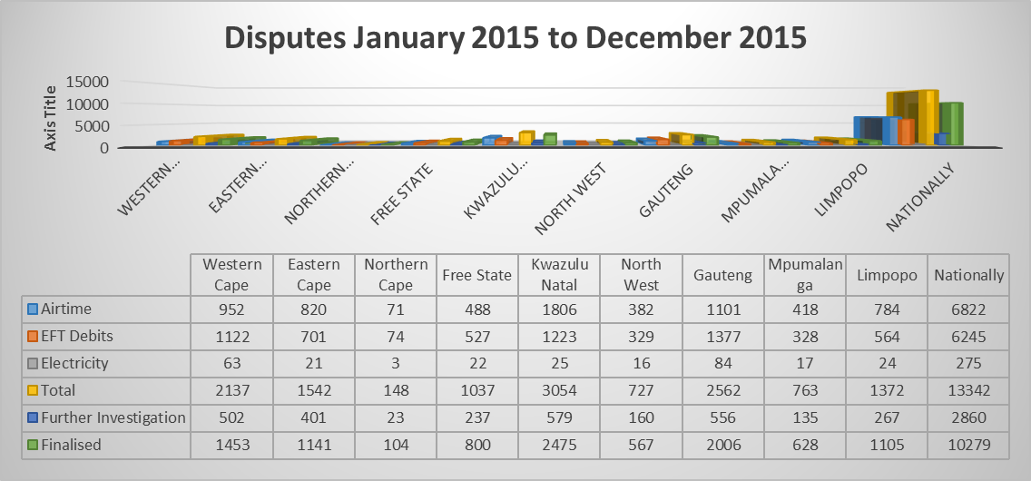
TREND ANALYSIS 2015
This is an indication of the breakdown of logged queries for the past period starting from January 2015 to December 2015
Total number of queries attended equals 13342, of which 2860 required further investigation and 10279 finalised.
Gauteng, Western Cape, KZN and Limpopo have got the highest queries
The airtime queries has been leading all throughout

Slide 39
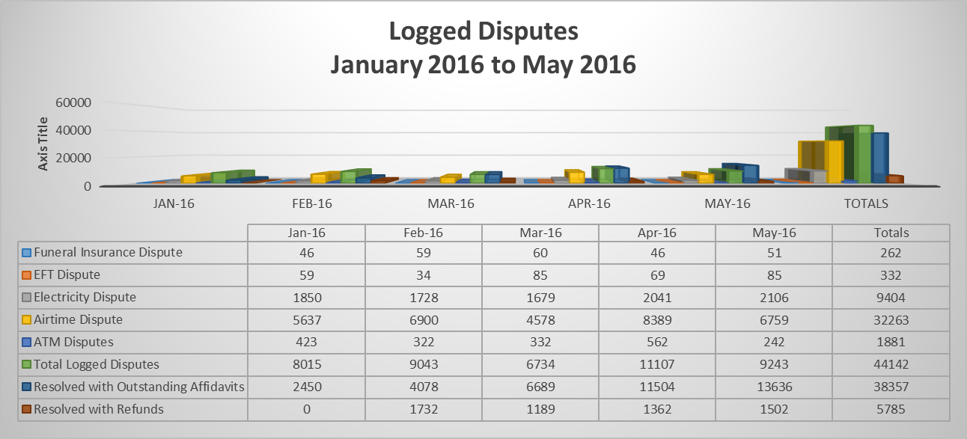
Logged Disputes - Jan 2016 to May 2016
Total number of disputes attended equals 19172, of which 7285 cases customers were finalised and 11887 required further investigation.
KZN, Eastern Cape, Gauteng and Mpumalanga record the highest queries
Airtime disputes is the highest to the disputes

Slide 40
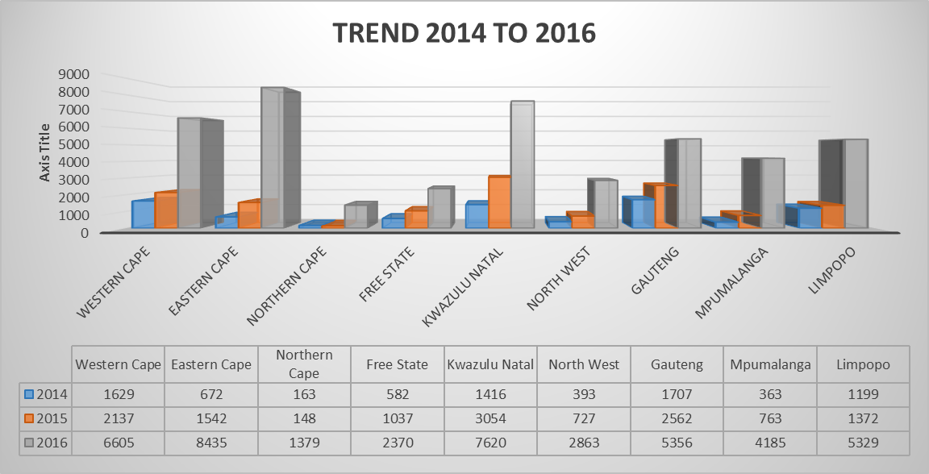
INCREASE IN LODGED DISPUTES

Slide 41
2015/16 Audited financial outcomes
FINANCIAL INFORMATION

Slide 42
2015/16 Expenditure – Economic Classification
Notes:
SASSA

Slide 43
Commentary on 2015/16 expenditure
SASSA’s budget allocation for the 2015/16 financial year amounted to R6,642 billion.
Over and above this allocation SASSA had an accumulated surplus of R1,366 billion.
The retained surplus was earmarked mainly for the projects geared towards the in-sourcing of payments (social assistance benefits)
National Treasury granted approval of R 621 million of the retained surplus to be spent in 2015/16 to fund once off critical projects
The planned estimated expenditure for the period under review was thus R7 263 551 billion in 2015/6 (R6,642 billion + R 621 million).
Actual expenditure by the end of the financial year was R6 904 129 billion.

Slide 44
2015/16 Expenditure per Programme
NB: Programme 1 Budget includes R2 billion Handling fees for Social Assistance transfers
Notes:
Variance utilised from the retained surplus

Slide 45
2015/16 Expenditure per Key Spending Items

Slide 46
2015/16 Expenditure per Key Spending Items

Slide 47
2015/16 Expenditure per location

Slide 48
Auditor General Report and Comments
AGSA’s opinion on the AFS – Unqualified Audit. The AG found that:
SASSA’s financial statements present fairly in all material respects, the financial position of the Agency as at 31 March 2016; and
SASSA’s financial performance and cash flows for the 2015/16 financial year were in accordance with SA Standards of GRAP and the requirements of the PFMA.
Predetermined objectives - Unqualified
Reliability of information: There were no material findings on the usefulness and reliability of the reported performance information.

Slide 49
Matters of Emphasis
Irregular expenditure closing balance of R1.1 billion
Fruitless and wasteful expenditure of R10.9 million
Internal control deficiencies:
Lack of sufficient review and oversight to ensure compliance to applicable legislation
Timely implementation of proper record keeping, monitoring and review processes not implemented in a timely manner
Investigations (Fraud and compliance unit, SIU and NT) as a result of fraudulent actions that could result in possible irregular and fruitless expenditure

Slide 50
IRREGULAR EXPENDITURE –PER ANNUAL REPORT-2015/2016
Notes:
R18 million irregular also incurred due to SASSA sharing offices (leases) with provincial DSD and when DSD offices moved offices did not inform SASSA and SASSA had incurred costs on leases
R316 million –
R414 million – this is a accumulating transaction from 2012 – 2015. Security companies were appointed in all SASSA offices. When their term of office expired they could not be terminated because the bids were not responsive. SASSA extended the contract with higher costs. NT was of the opinion that SASSA should not have extended the contracts instead went on a new process (apply for deviation) and allow the term to expire before they extend the contract
R223 million – this was incurred as far back when SASSA took over the grant administration. Northern Cape had a contract with Trifecta but the lease documents could not be found. National Treasury was of the opinion that SASSA did not have effective record/document management. A court process was initiated. The Trifecta contract was one of the contracts that were migrated from DSD to SASSA
R74 million -

Slide 51
Analysis of irregular expenditure for 2015/2016
A total of R18 million in irregular expenditure was incurred during the 2015/2016:
R16 million was due to lease contract that expired and never renewed on time
R174 342.47 related to the irregularities during the hiring of halls for payment of beneficiaries
The balance of R 2 million related to irregularities committed on procurements other goods and services
As at 01 April 2015 the balance for irregular expenditure was R93 million

Slide 52
Analysis of irregular expenditure for 2015/2016
The following were moved from the possible irregular expenditure to irregular expenditure after pronouncement by National treasury:
R316 million on re-registration of beneficiaries incurred in 2012/2013
R223 million relating to lease payments made to Trifecta/Delta company for contracts entered in 2006 and 2007
R74 million on forensic investigations paid to SAB&T firm
National Treasury further declared an amount of R414 million paid to physical security companies to be irregular expenditure
A irregular expenditure amounted to a total of R1.1 billion as at 31 March 2016

Slide 53
Recommendations
It is recommended that the Portfolio Committee on Social Development notes
SASSA 2015/16 Annual Performance Report; and
SASSA financial statements for 2015/16.

Slide 54
Thank you

