Slide 1
Presentation to Portfolio Committee on Telecommunications and Postal Services
Costs to Communicate
September 2016

Slide 2
Table of Contents
-Telkom’s is committed to making communications affordable
- Developments in the Wholesale space
- Developments in the Retail space
- Challenges facing the ICT Sector
- Recommendations

Slide 3
Making Communications more affordable
What we have done over the past year…
As stated in our annual report the South African ICT industry generates approximately R240 per annum in revenues and
contributes 61% to ICT revenue
There has been an increasing trend from fixed access to wireless connectivity
Shift away from voice to internet connectivity
TELKOM
Deep functional separation and launch of Openserve in October 2015
Legacy
New Generation

Slide 4
Making Communications more affordable (cont)
Developments in 2016
18.4% increase in mobile voice & subscriptions
72% increase in mobile data traffic
38.7 % increase in broadband traffic volumes
More data centric
In FY2016 there was a 120% capacity growth in the NGN – allows for economies of scale = high-speed data services at affordable prices;
Revamping access network using multi-service access nodes (MSANs) which are scalable and flexible and enable different types of services from the same access node;
Simple and compelling bundles and converged products allow for affordable pricing
Reducing costs to our wholesale customers increases access to and affordability of broadband
Broadband ecosystem revitalised to provide affordable wired broadband to a larger section of the South African population
Cheap lower fixed broadband entry speed – 1Mbps to enable entry of lower LSM groups
Even though the number of fixed line subscribers has not increased significantly, there has been a significant 37.8% increase in broadband traffic over the last year – to 471 958 terabytes

Slide 5
Pricing Developments in the Wholesale space
The per unit prices across the wholesale product range has decreased by approximately 63% since April 2015
SAIX via high speed broadband prices have decreased by more than 25% per annum since 2013
IP Connect prices have decreased significantly with the price of the entry speeds decreasing by 82% in 2015 and a further 57% in June 2016
This is an enabler for Openserve’s downstream customers to compete effectively and pass on savings to consumers and businesses.

Slide 6
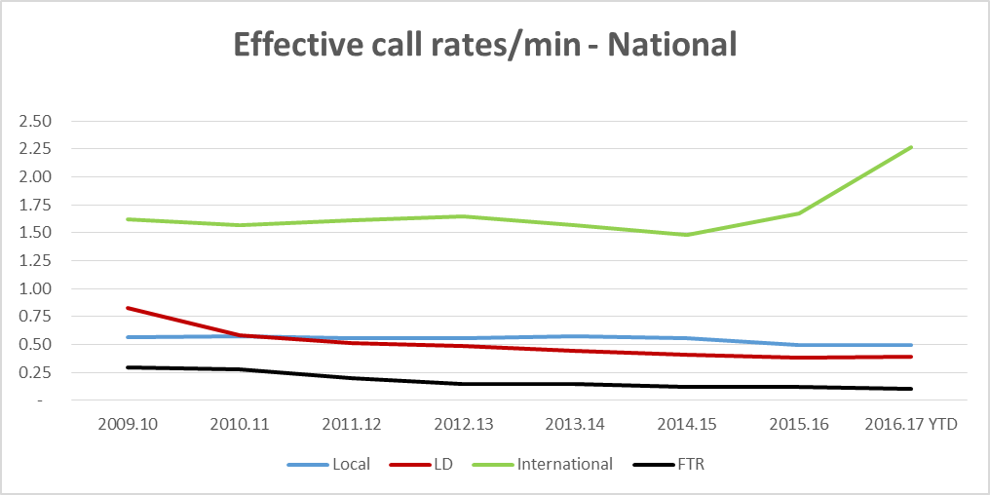
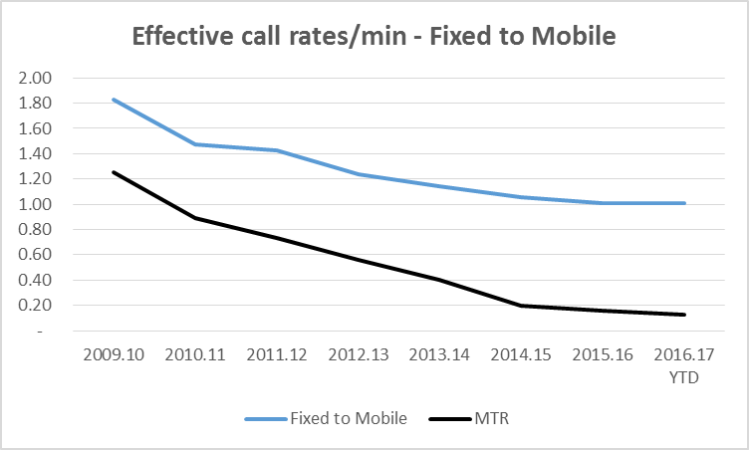
Developments in the Retail space (Fixed services)
We have consistently reduced call rates over the past 10 years and particularly to be in line with the CTR glide path. We have also simplified our national tariff structure by collapsing local and long distance rates into a single rate, effectively dropping long distance call rates

Slide 7
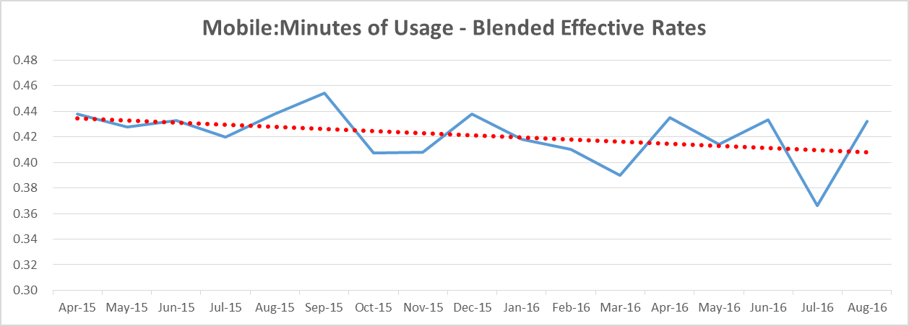
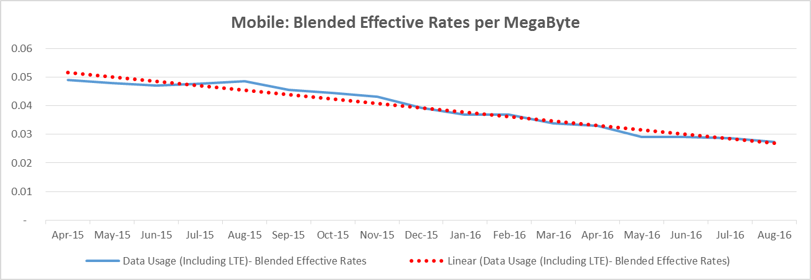
Developments in the Retail space (Mobile Services)

Slide 8
Developments in the Retail Space (cont)
Telkom mobile has had a disruptive effect in the mobile space putting downward pressure on market prices
Subscriber growth has increased of 54.6% per annum since launch in 2011
Introduced SIM only contracts and month to month packages since early 2015
With the introduction of LTE voice calls are now transmitted as data, not separately as in the past
Introduction of Free Me in July 2016:
Free on net calls
50 free SMS’s per day
Free use of Telkom Wi-Fi hotspots
Free calls and messaging on Whatsapp, BBM and Viber (up to 2GB usage pm)

Slide 9
Developments in the Retail Space (cont.)
Telkom mobile has had a disruptive effect in the mobile space putting downward pressure on market prices
Subscriber growth has increased of 54.6% per annum since launch in 2011
Introduced SIM only contracts and month to month packages since early 2015
With the introduction of LTE voice calls are now transmitted as data, not separately as in the past
Telkom is providing disruptive, flexible consumer focused data based packages called Free Me
Free on net calls
50 free SMS’s per day
Free use of Telkom Wi-Fi hotspots
Free calls and messaging on Whatsapp, BBM and Viber (up to 2GB usage pm)

Slide 10
Threats to lowering the costs to communicate in the mobile space
Telkom still does not have access to <1GHz spectrum which increases the costs of network build. This necessitates that Telkom enter into roaming agreements to provide mobile telecommunications services;
The current ITA for spectrum is likely to entrench the dominance of the incumbents with adverse effects on the competitive process and the ability to lower prices; and
Telkom continues to service fixed line telecommunications access at a loss in order and ensure that marginalized communities have access to services. We are, however, in the process of finding ways to decrease the access line deficit (ALD).

Slide 11
Recommendations
ICASA to conduct a chapter 10 enquiry into competition in the broadband market and associated pricing;
Regulated national roaming of all operators with significant market power;
In order to level the playing field, Telkom be assigned a sub 1 Ghz spectrum;
Regulatory recognition of the impact of access line deficit; and
Solutions need to be found to remove onerous legacy universal service obligations which artificially raise the costs of providing fixed services by Telkom in a highly dynamic ICT world and further distort the playing fields to the disadvantage of Telkom

