Slide 1
The Compensation Commissioner for Occupational Diseases (CCOD)
Presentation to
Portfolio Committee on Health
Progress in addressing challenges at the CCOD
7 September 2016

Slide 2
Overview
Performance highlights 2015/16 FY & Q1 (2016/17 FY)
Overcoming challenges
The way forward

Slide 3
Performance Highlights
Submission of Strategic Plan and Annual Performance Plans
Governance Committees (Advisory, Risk and Audit & Risk) in place and meeting regularly
Annual Financial Statements for 2010/11 FY and 2011/12 FY awaiting Actuarial Valuation Report for incorporation – thereafter submission to Auditor-General of South Africa (30 Sept 2016)
Revenue collection and claimant payments improved
Performance outputs improved
Innovations in service delivery
Integration of compensation systems

Slide 4
Performance Environment
Support of trade unions, Chamber of Mines & Gold Mining companies, social partners, ex-mineworker associations
Global Fund support for One Stop services in neighbouring countries
World Bank support for tracking and tracing
Involvement of other departments – facilitated by Presidency / Premier’s office in Eastern Cape
Externally – class action on Silicosis and Tuberculosis compensation; settlement by 2 mining companies in May 2016 - silicosis

Slide 5
Performance Environment
Business process reforms
Registry
Database
Process mapping
Website (www.health.gov.za/ccod)
Weekly monitoring of certifications and payments
Finance team and medical doctors in place
Seconded senior managers
Collaboration / partnerships
Across government and agencies
Neighbouring countries
Stakeholders
Social partners

Slide 6
Selected Performance Indicators
Indicator | Target (15/16) | Actual (15/16) | Q1 Target | Q1 Actual
Benefit medical examinations | 10 500 | 15 318 (+46%) | 3 750 | 4 669 (+25%)
Claims certified at MBOD | 8 000 | 7 233 (-10%) | 3 000 | 4 754 (+58%)
Claims paid | 3 000 | 1 775 (-41%) | 500 | 633 (+27%)
Inspections of mines and works | 40 | 77 (+93%) | 13 | 14 (+8%)
Outreach | 10 | 34 (+240%) | 3 | 8 (+167%)
Payments of TB | 750 | 598 (-20%) | 193 | 209 (+8%)

Slide 7
Number of Paid Claimants (2014/15/16)

Slide 8
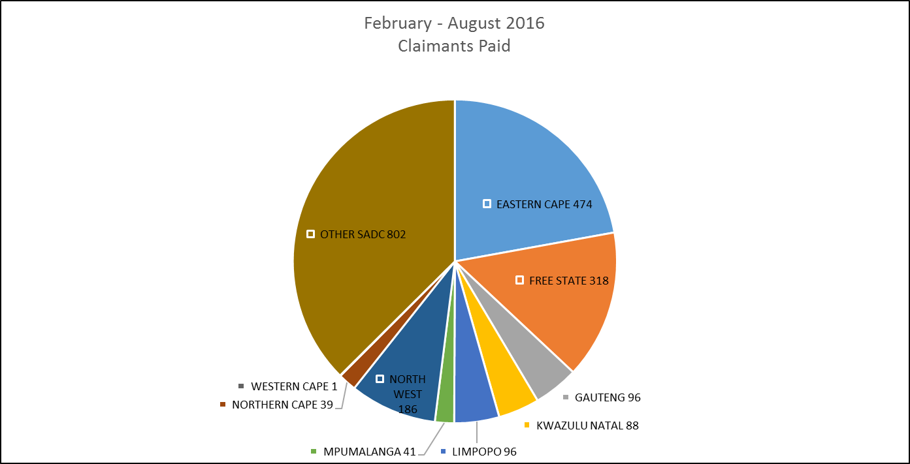
Provincial / SADC Distribution of Paid Claimants (February – August 2016)

Slide 9
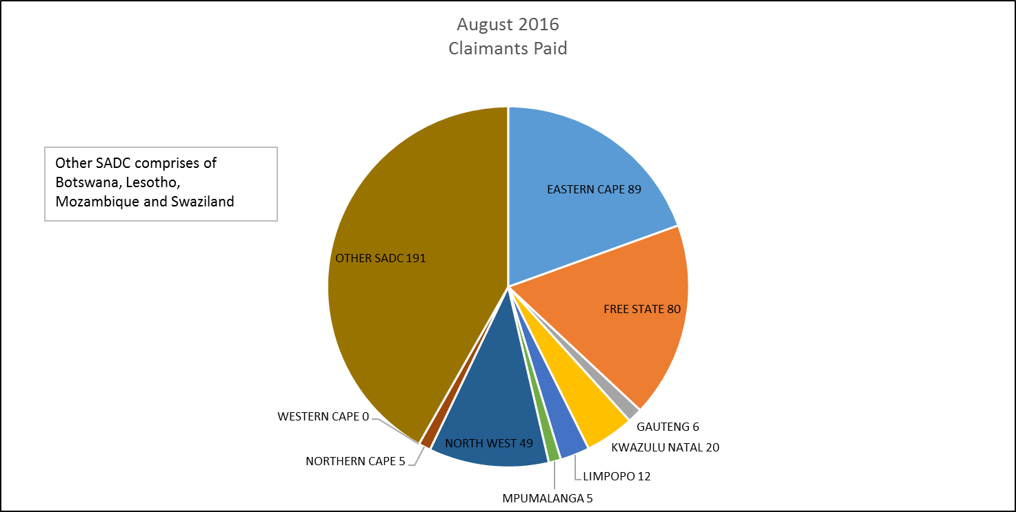
Provincial / SADC Distribution of Paid Claimants
(August 2016)

Slide 10
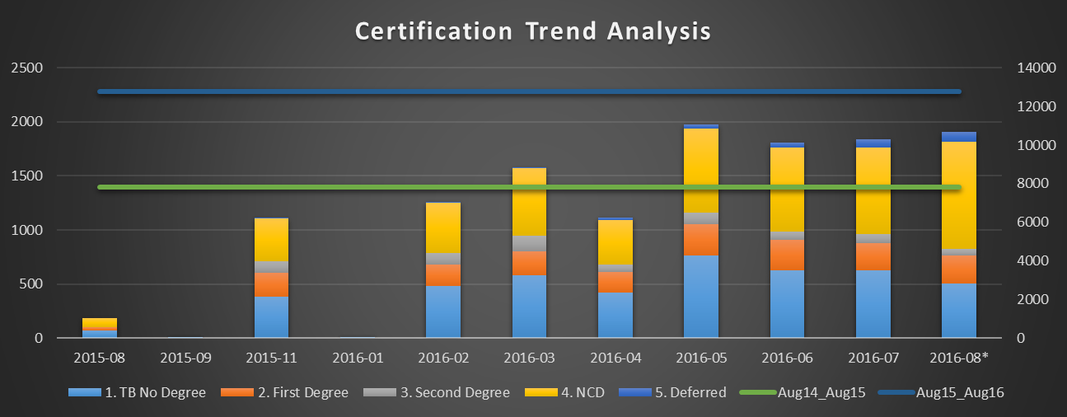
MBOD Certifications
Primary (Left Axis) – Number of Certifications per month
Secondary (Right Axis) – Cumulative certifications over the 12 months

Slide 11
Non-Performance
Legacy problems going back many years
Outdated information technology systems and business processes
Lack of staff in legal, actuarial, medical, analytic / epidemiological sciences
Lack of finances
Revenue covers income protection
Voted funds for administration, medical services
Personnel management, work ethos and culture
Resignation of key personnel / inability to recruit health professionals

Slide 12
Of special note
Flawed model of revenue covering only income protection
Externalised costs of administration, medical assessments and health care to government
Major differences between compensation for injuries and compensation for diseases
Bulk of ex-workers in labour sending areas or neighbouring countries
Integration of compensation systems
How to deal with legacy issues – mainly ex-workers
Proposal for current 400 000 workers

Slide 13
Future model: MBOD/CCOD
Integrated Compensation System
MBOD- 400k files
CCOD
200k
Controlled Mines & Works - 400k
??? Ex-workers
Controlled Mines & Works - 400k

Slide 14
Budget / Expenditure (15/16 FY) – voted funds
Classification | Budget R ‘000 | Expenditure R ‘000 | (Over) / Under | % Spend
Compensation of Employees | 28 283 | 29 285 | (1 002) | 103.5%
Goods and services | 23 886 | 14 652 | 9 234 | 61.3%
Transfer Payments | 3 363 | 3 445 | (82) | 102.4%
Machinery and equipment | 3 112 | 2 041 | 1 071 | 65.6%
Total | 58 644 | 49 423 | 9 221 | 84.3%
*Covers Medical Bureau for Occupational Diseases as well

Slide 15
Budget / Expenditure 16/17 FY - Q1 (voted funds)
Classification | Budget R ‘000 | Expenditure R ‘000 (Q1) | % Spend
Compensation of Employees | 31 461 | 7 733 | 24.6%
Goods and services | 24 037 | 4 965 | 20.7%
Transfer Payments | 3 541 | 61 | 1.7%
Machinery and equipment | 2 604 | 59 | 2.3%
Total | 61 643 | 12 818 | 20.8%
*Covers Medical Bureau for Occupational Diseases as well

Slide 16
Acknowledgement
Minister and Deputy Minister of Health
Deputy Minister of Mineral Resources
Director-General, Deputy Director-General Anban Pillay and Chief Financial Officer Ian van der Merwe
Staff of MBOD/CCOD
Advisory Committee, Risk Committee and Audit and Risk Committee
Chamber of Mines and Gold Working Group, trade unions
World Bank, Global Fund and other social partners
Other national, provincial and neighbouring country governments

Slide 17
Thank You
kistnb@health.gov.za

