Slide 1
BRIEFING THE PORTFOLIO COMMITTEE ON WATER AND SANITATION
ON THE
ATTAINMENT OF THE MILLENNIUM DEVELOPMENT GOALS AND INCORPORATION OF THE SUSTAINABLE DEVELOPMENT GOALS
Presented by:
Mr Sifiso Mkhize
Acting Director-General
7 September 2016
PRESENTATION TITLE
Presented by:
Name Surname
Directorate
Date

Slide 2
Objectives of The Presentation
Transition from the MDGs to SDGs
Encapsulating Goal 6 of SDGs
Achievements, challenges, Risks & Resolutions
To present South Africa's response
To highlight critical issues and challenges
To present perspectives on the way forward

Slide 3
Understanding the Millennium Development Goals
The Millennium Declaration commits governments to a clear agenda for combating poverty, hunger, illiteracy, disease, discrimination against women, shelter and environmental degradation
In September 2000, 189 countries (147 Heads of State) signed the declaration
Initially there were 8 goals, 18 targets and 48 indicators
In 2008 framework adjusted: 20 targets and 60 indicators
Target date: 2015 (reference year 1990)

Slide 4
The 8 MDG’s
Eradicate extreme poverty and hunger
Achieve primary education
Promote gender equality
Reduce child mortality
Improved maternal health
Combat HIV/AIDS malaria and other diseases
Ensure environmental sustainability
Develop a global partnership for development

Slide 5
Please note: No Water MDG: Access to Water Services reflected as a sub-target under Goal 7, Target 7C
Target 7C: Halve proportion of people without sustainable access to safe drinking water (Urban & Rural) -
Target 7C: Halve proportion of people without access to basic & acceptable sanitation services (Urban & Rural)
NB: Focus is on ‘halving the backlog’

Slide 6
DWS Response to MDGs
Preceding the setting of the MDG goals in2000, SA already committed itself to ensuring access to basic water services in 1994
Target set to address total backlog vs. halving the backlog
DWS (DWA) established a dedicated programme, policy, criteria and legislation, funding
DWS established a comprehensive database and information system
Extensive political commitment and will

Slide 7
4. Progress: South Africa has done well !
Excellent policies and legislation
Dedicated programmes and funding
Already achieved the water services MDG target in 2005 (halving the backlog)
All Provinces achieved MDG target
DWS established a comprehensive Water Services business framework

Slide 8
The achievements
The achievements to be viewed against 2 indicator sets and or criteria:
Global (Africa) norms and standards (varying from 500m to 5km access to water)
The South African RDP norms (access within 200m)
The MDG reports present performance against global norms

Slide 9
Basic Water Supply Achievement (Meeting Global norms)
1996
2014/15
infrastructure
2014/15 operational
supply
Access to
76.6%
98%
91%
Backlog
23. 4%
2%
9%
Backlog target: 88.3 % - achieved

Slide 10
N.B. International alignment
No formal international basic water services criteria
Africa criteria = access from 500m to 5km
South African MDG Country report now aligned to reflect comparable figure of access to operational water services = 91% for SA (2011)
10

Slide 11
Basic Water Supply Achievement (Meeting RDP norms)
1996
2014/15
infrastructure
2014/15 operational
supply
Access to
59%
96%
86%
Backlog
41%
4%
14%
Backlog target: 79.5 % - achieved

Slide 12
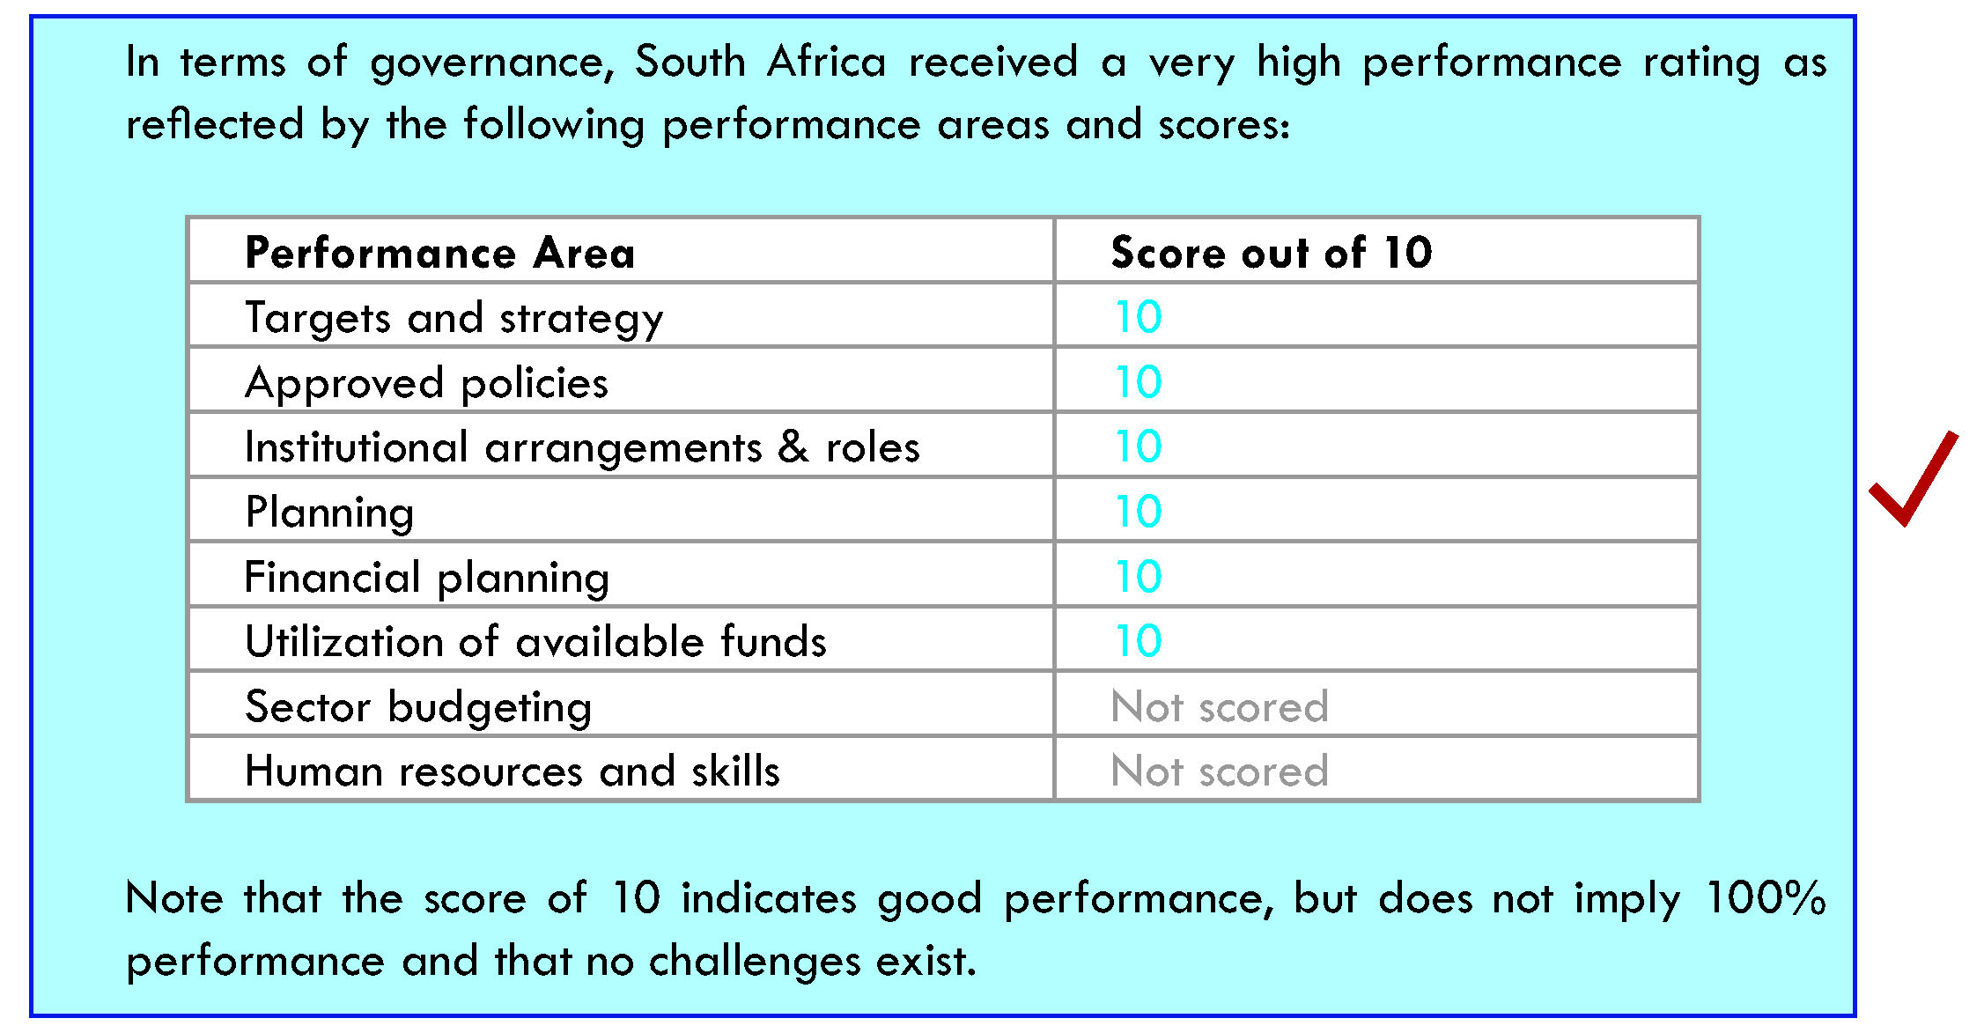
External & International Assessment

Slide 13
Success Factors
Political will (Constitution & priority)
Dedicated leadership and drive
Dedicated programmes
Goals and strategies
Institutionalizing and sector mobilisation
Policy, norms and standards
Dedicated funding
Implementation programme (Multi approach)
Effective planning
Integrated programme & partnerships
Tools
Tactics
Knowledge base
Champions.

Slide 14
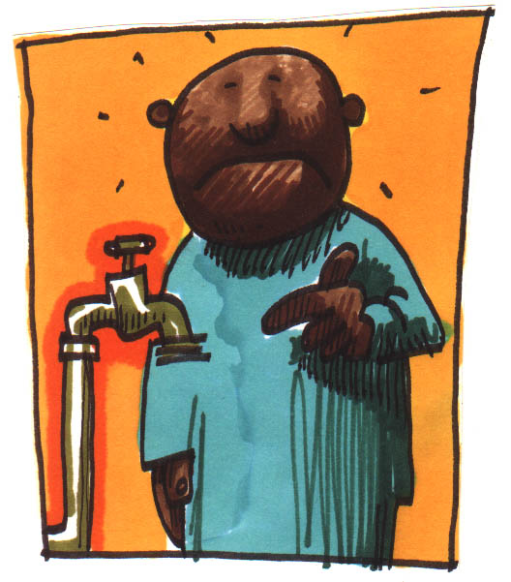
The Reality Experience

Slide 15
Reality experience
Service levels (operational challenges):
Access to RDP infrastructure = 96%
Access to operational infrastructure = 86% (68% in priority 24 DMs) (infrastructure with water but not always reliable)
Access to reliable services = 65% (42% in priority 24 DMs) = public frustration
Major drop in delivery trend = 0 to 0,5 % /annum
2002/3 DWS (DWA) instructed to back-off
Dispersed programme: MIG = DCoG and housing services and sanitation = DHS
Limited coordination since 2006/7

Slide 16
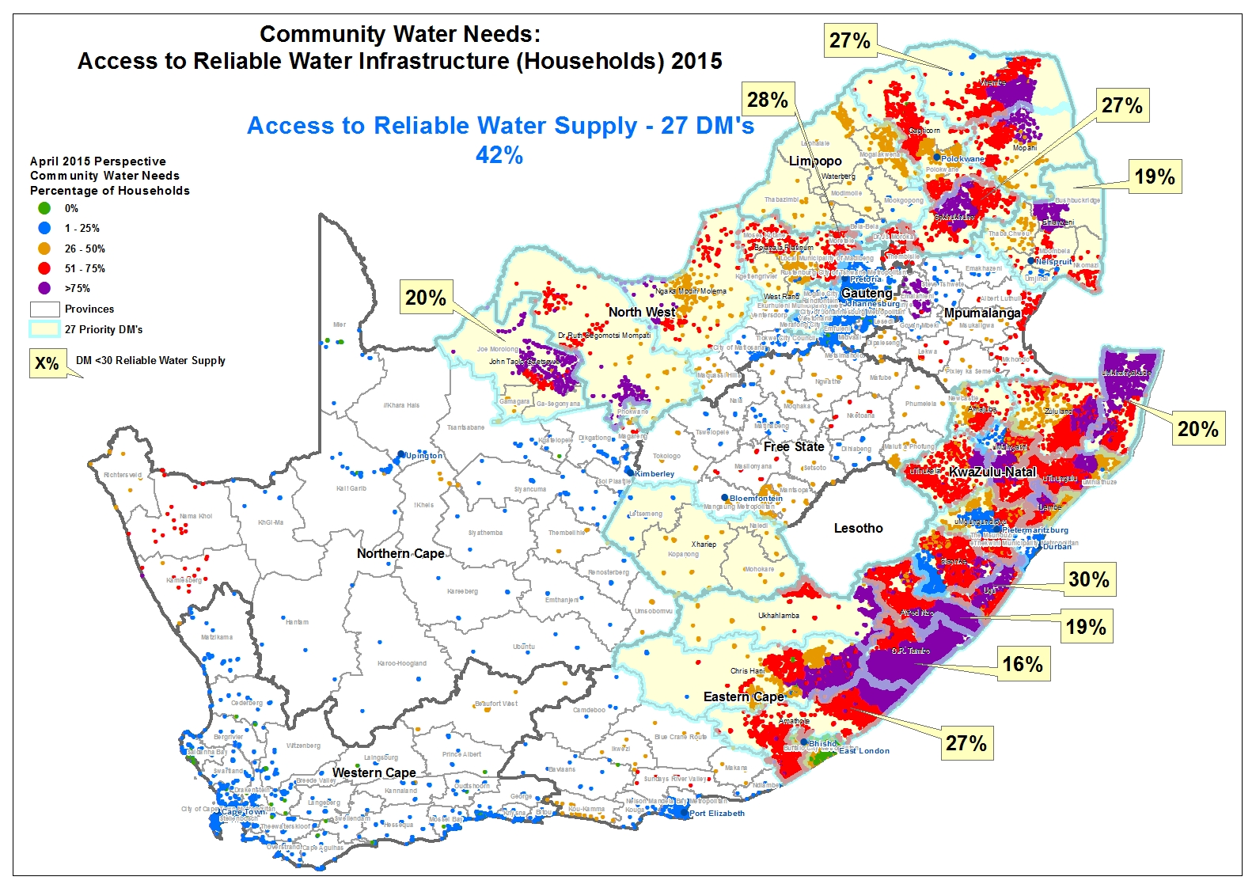
16

Slide 17
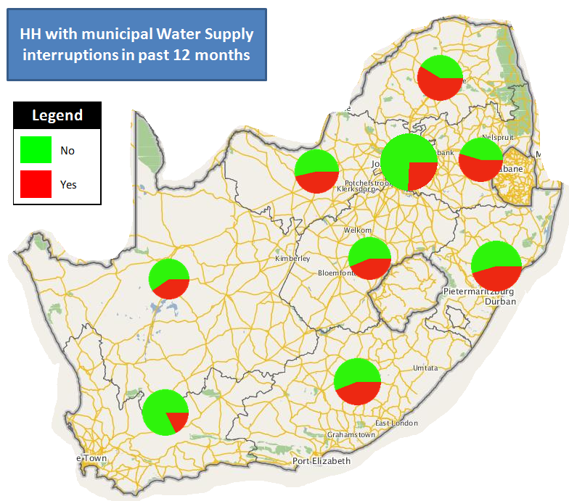
Interruption Perspectives
Census 2011

Slide 18
The MDGs Lessons Learnt
The key lesson learnt was the need to focus on sustainable and reliable services as the outcome, with associated interventions and governance, and not only on once of infrastructure delivery
The drive was an internal one and not only an international obligation (SA human right)
Many success factors contributed to the achievement of a positive outcome, but the same ones also became risk and failure factors (programme management, coordination, leadership)
The need to deal with a moving target
The need to deal with water services as a business and the application of life cycle and value chain approaches and principles
18

Slide 19
The MDGs: Key messages - Way forward
Dedicated water goal was needed
4x priority focus areas:
finish the unfinished business (universal access)
Manage the moving target,
focus on sustainable, reliable, affordable and safe services
Recover failures and poor services
Maintaining existing good services
19

Slide 20
Background to SDG’s (Goal 6)
The key priority over the past 20 yrs was and still is the need to ensure and facilitate access to basic water services
From a water resource management point of view the key challenges identified are:
Water security and the unsustainable use of water
Pollution of fresh water resources
Degradation of ecosystems
Managing shared water courses and basins
Disaster management and climate change
Recently an important issue that came to the fore is to promote and manage water within the country’s developmental agenda: economic, social and environmental growth and development.
20

Slide 21
South African Water Challenges & Response
Limited surplus fresh water resources
Responses
Need to:
support and facilitate social, economic and environmental growth and development
respond to priority drivers and NDP
improve and rethink water management approach and solutions
address key concerns: Pollution, ensuring water security, environmental degradation, disaster management
commitment to ensure sustainable basic services
apply integrated management approach
address the issue of sustainability
21

Slide 22
The Post 2015 Agenda Setting of a Water related SDG: Process issues
As an outcome of the Rio+20 conference on sustainable development, it was decided (Internationally) to develop a Post 2015 global agenda in this regard.
This, together with the fact that the MDG process ended in 2015 and there was a need to finish some unfinished business and others to continue, resulted in the decision to develop specific sustainable development goals (SDGs), and thereby get all countries to commit to the achievement of these goals and targets
22

Slide 23
The Post 2015 Agenda Setting of a Water related SDG Process issues
Various processes were developed to facilitate country and interest group input .
SA contributed via:
Country processes (Lead by Dept of International Relations),
Direct Open Working Group (Macro development team) participation
International water sector interest groups (UN facilitated work sessions, Budapest high level conference, AMCOW).
Based on its experience and achievements, DWS was also invited to be part of international expert teams to prepare input towards the setting and development of a dedicated water SDG.
23

Slide 24
Transition from MDGs to SDGs (1)
Key objectives of the South African and international water industry were:
The establishment of a dedicated water goal
The setting and development of meaningful and relevant sub goals and target
The need to address and ensure effective capacity, resources and leadership to facilitate the achievement of the set targets
24

Slide 25
Transition from MDGs to SDGs (2)
4 specific and focussed water business areas were identified:
Focus on ensuring reliable & sustainable basic water and sanitation services
Specific focus on water resource management
Placing and managing water within a development agenda
Ensuring effective integrated water management
25

Slide 26
4x Focus Areas
Establish Water within growth and development Agenda
Focussed Water resource management
3
2
1
Ensure Access to reliable water services
Integrated water management
All levels: International to local
4
26

Slide 27
4x Focus Areas
Water within growth and development
2
Water resource management
3
1
Access to basic water services
Water security
social
Ecosystems &Pollution management
economic
Disaster management
environmental
Shared rivers and basins

Slide 28
The SDGs Introductory message and principles
The SDG contains 17 goals to be attained by 2030
The new goals reflect a flexible global vision, recognising that each country faces specific challenges to achieve sustainable development
This includes a dedicate water goal, Goal 6: Ensure availability and sustainable management of water and sanitation for all
However, water is also duplicated, reflected and or implied in various other goals
28

Slide 29
The SDGs Goal 6: Ensure availability and sustainable use of water an sanitation for all
Goal 6 has 6 sub-goals/targets:
By 2030 achieve universal access to safe and affordable drinking water
By 2030 achieve access to safe and adequate sanitation (specific focus on needs of woman and girls)
Improved water quality through reduced pollution
Improved water-use efficiency
Implement integrated water management
Protect and restore Ecosystems

Slide 30
SDGs Associated Water Goals
Water also implied and or reflected under:
Goal 1 (End poverty): access to basic services and disaster management
Goal 2 (Hunger & food security): double agricultural productivity, small-scale farmers, maintain ecosystems
Goal 3 ((Health): water-borne diseases, water pollution
Goal 8 (Sustainable growth): resource efficiency and environmental degradation
Goal 9 ( Build resilient infrastructure): support economic development, human well-being and equitable access for all, increase resource use efficiency, apply environmental sound technologies

Slide 31
SDGs Associated Water Goals
Water also implied and or reflected under:
Goal 11: (Cities): ensure basic services, management of water related disasters, resource efficiency, climate change, disaster management
Goal 12 (sustainable consumption): 12.2: achieve sustainable management and efficient use of natural resources; water pollution
Goal 13: (Climate change)
Goal 14: (Marine ecosystem): 14.1: reduce land-based pollution (rivers)
Goal 15: (Terrestrial ecosystems): 15.1: ensure conservation, restoration and sustainable use of water ecosystems
Goal 17: (Global partnerships): finance, technology, skills, policy, information

Slide 32
The SDGs Response & comments
Goals formally agreed to by Heads of State September 2015
Goals formally applicable from January 2016
DWS supports the setting of a formal and dedicated water goal
DWS appreciates the approach to apply a flexible approach to allow each government to set its own national targets

Slide 33
Encapsulation of SDGs in Water & Sanitation Sector Programmes (1)
South Africa is self-driven in this regard and DWS has already initiated most of the goal initiatives:
Ensuring universal and sustainable access to basic water services
Focused water resource intervention: National Water Resource Strategy 2, reconciliation strategies, water use efficiency,
Placing water within the development agenda: align with NDP and macro strategies
Classification and Resources Quality Objectives, Water Quality & reliability

Slide 34
Encapsulation of SDGs in Water & Sanitation Sector Programmes (2)
Need to ensure effective and timely implementation
Need to invest in information management, focussed delivery programmes as well as skills and capability to deliver
Finalise the future institutional arrangements for the management of water resources, national and regional infrastructure
Water- Energy-Agriculture-Mining-Industry Nexus
Collaboration between DWS and entities e.g CMAs, Water Boards

Slide 35
The Water Services response
New programme already established in 2014 (1 year prior to SDG sign-off)
New Water Services target already approved by Cabinet July 2014 –focus on reliable services by 2019
Comprehensive approach adopted and reflected in Outcome 9 MTSF
Master planning of priority 27DMs
Integrated Programme management arrangements (PMO established)
Macro framework adopted to address infrastructure plus operations and maintenance, water security, improved governance as well as institutional intervention and accountability

Slide 36
The Way Forward
Formalize Water Resources baseline, targets and indicators by end 2016
SDG mobilization (2016 ): set up programmes for delivery, sector mobilization, resources (budget/Finance, skills & capability)
Ensure implementation readiness
Address information and reporting requirements (2016): e.g. performance benchmarks for each sub goal and monitoring system
DWS Restructuring & Institutional arrangements
Legislative Review
Develop & Implement National Water Master Plan

Slide 37
Thank you

